Slide 1

MACHINE LEARNING PROJECT ON HEART DISEASE
MADE BY :
SAUMYA ACHANTANI
18CSU194

Slide 2
PROBLEM STATEMENT
INTRODUCTION TO HEART DISEASE:
Amongst all organs we have,heart is the most significant.
The factors which affect heart are blood pressure, cholestrol, sugar level etc caused due to unhealthy lifestyle,family history and other reasons like age.
Symptoms include chest pain, breathlessness,fast heart beat etc.
Heart disease is diagnosed through electrocardiogram test.
EDA:
To study and analyze the number of people suffering from heart diseases, various factors which are majorly responsible for it and relationship among these factors.
SUPERVISED MACHINE LEARNING MODELS:
To apply supervised learning( both classification and regression) .

Slide 3
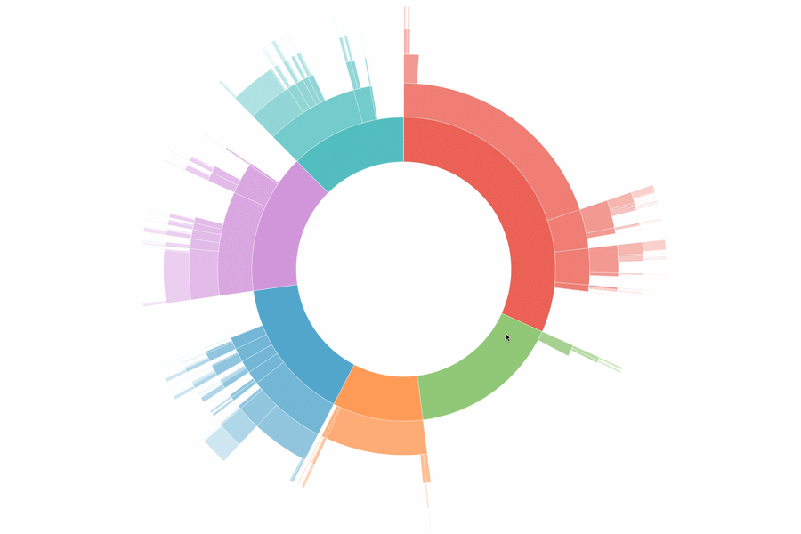
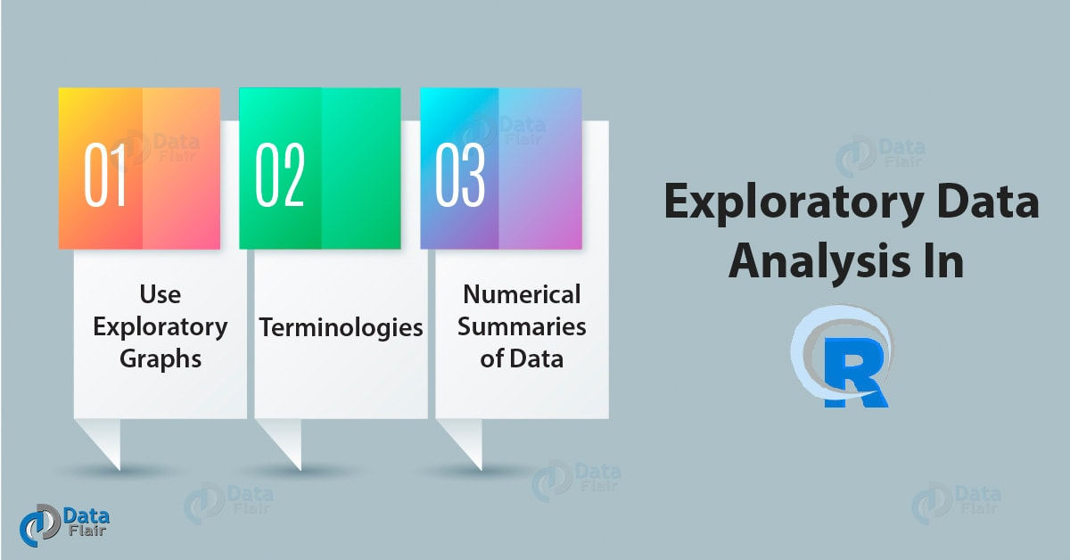
EXPLORATORY DATA ANALYSIS

Slide 4
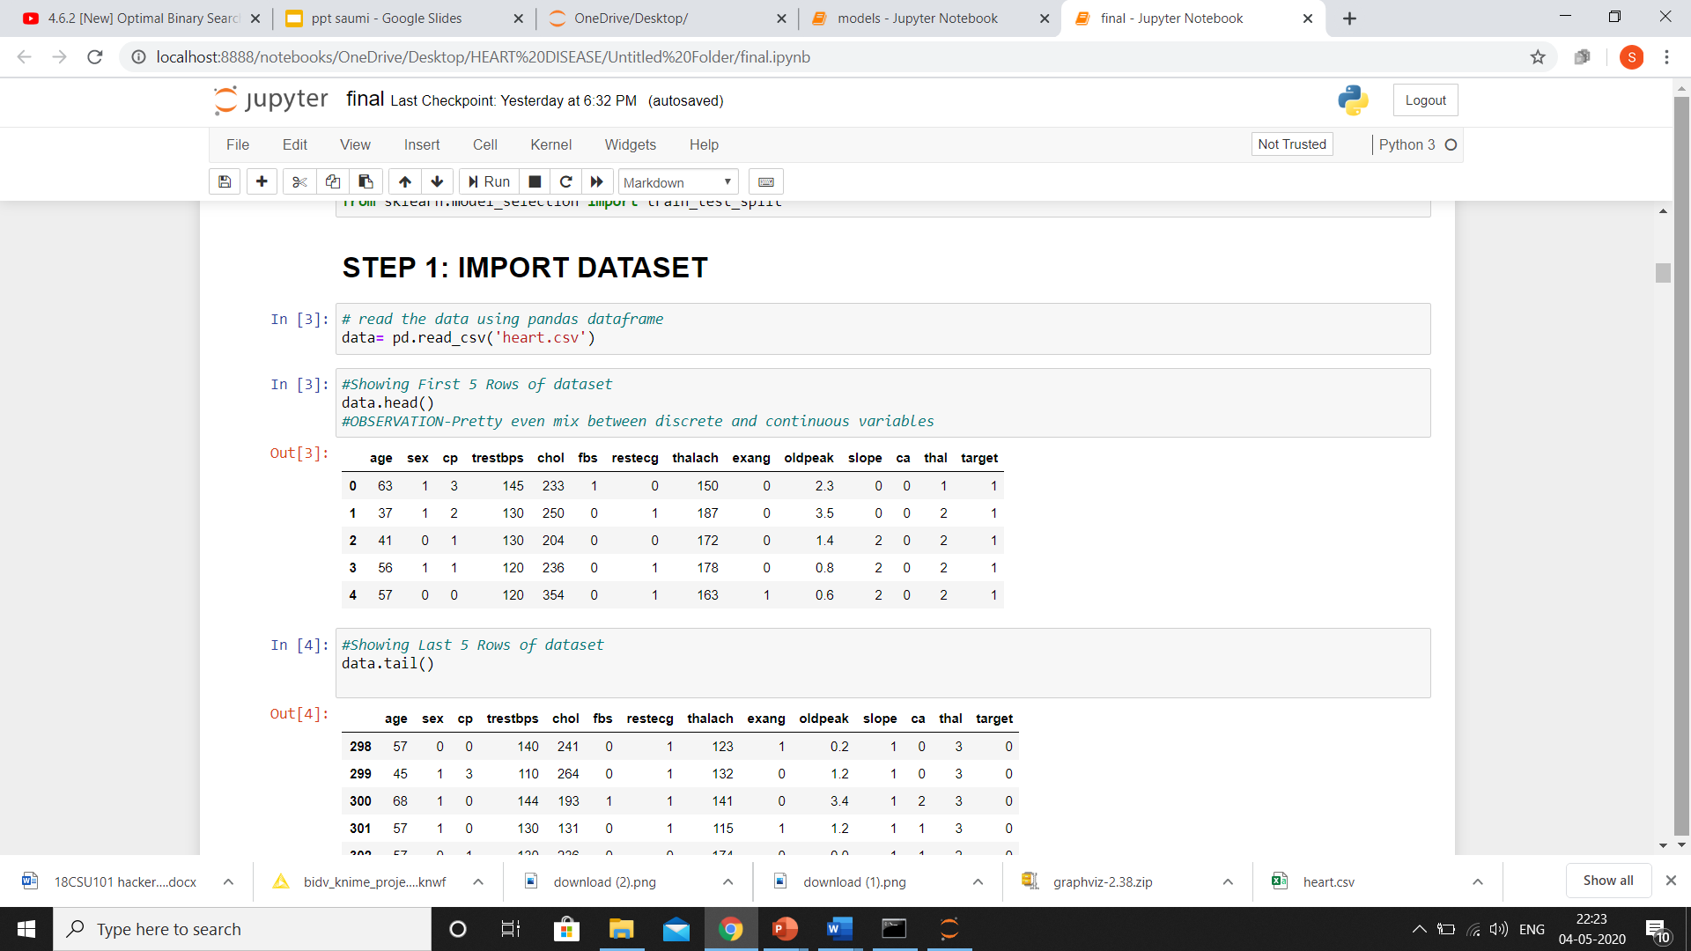
DATASET OVERVIEW

Slide 5
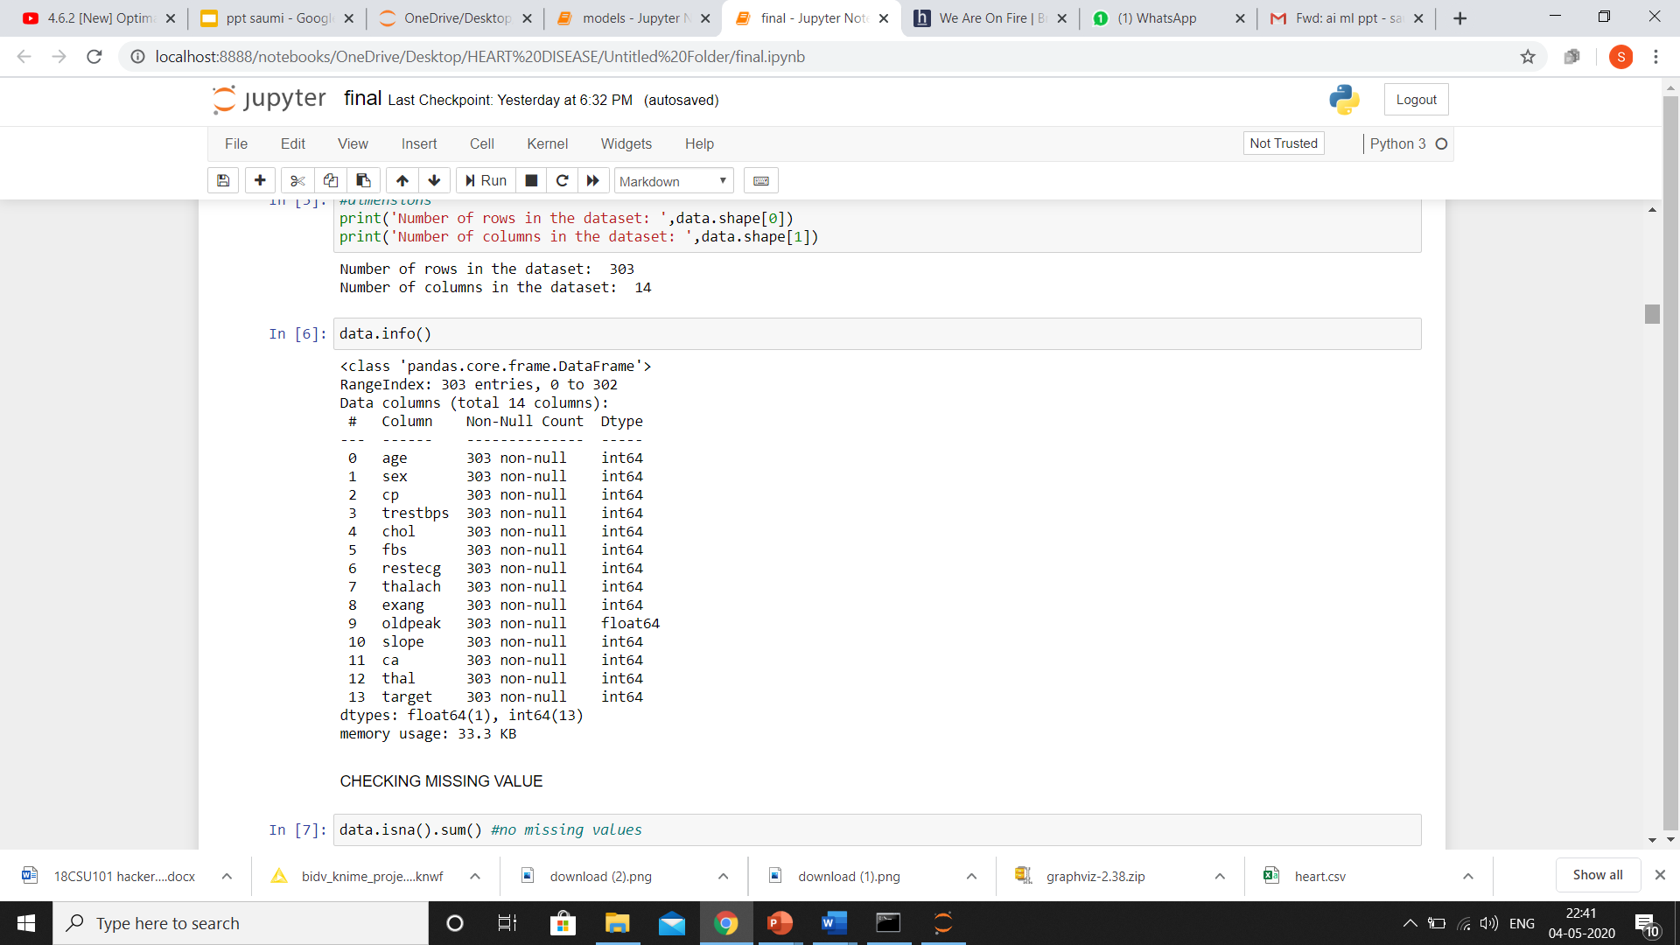
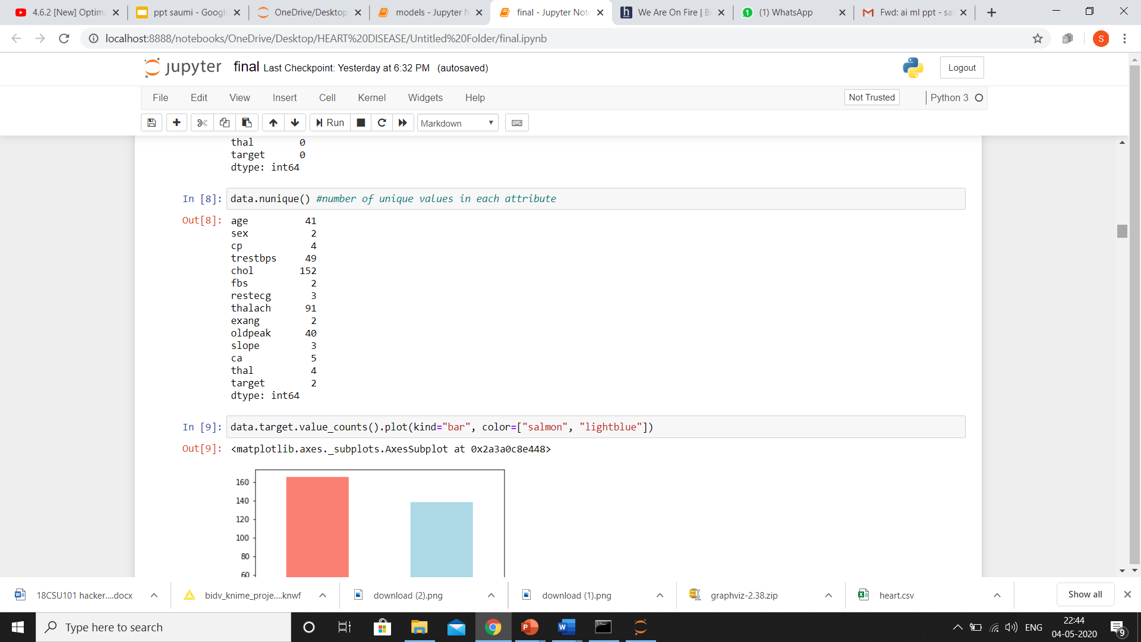
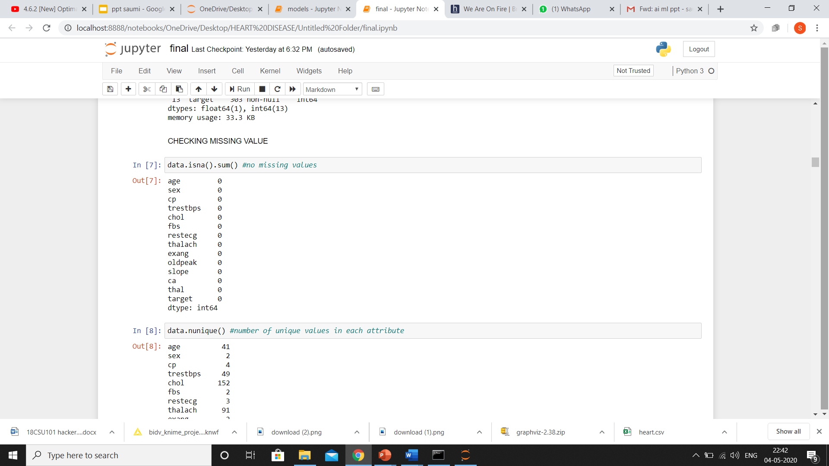
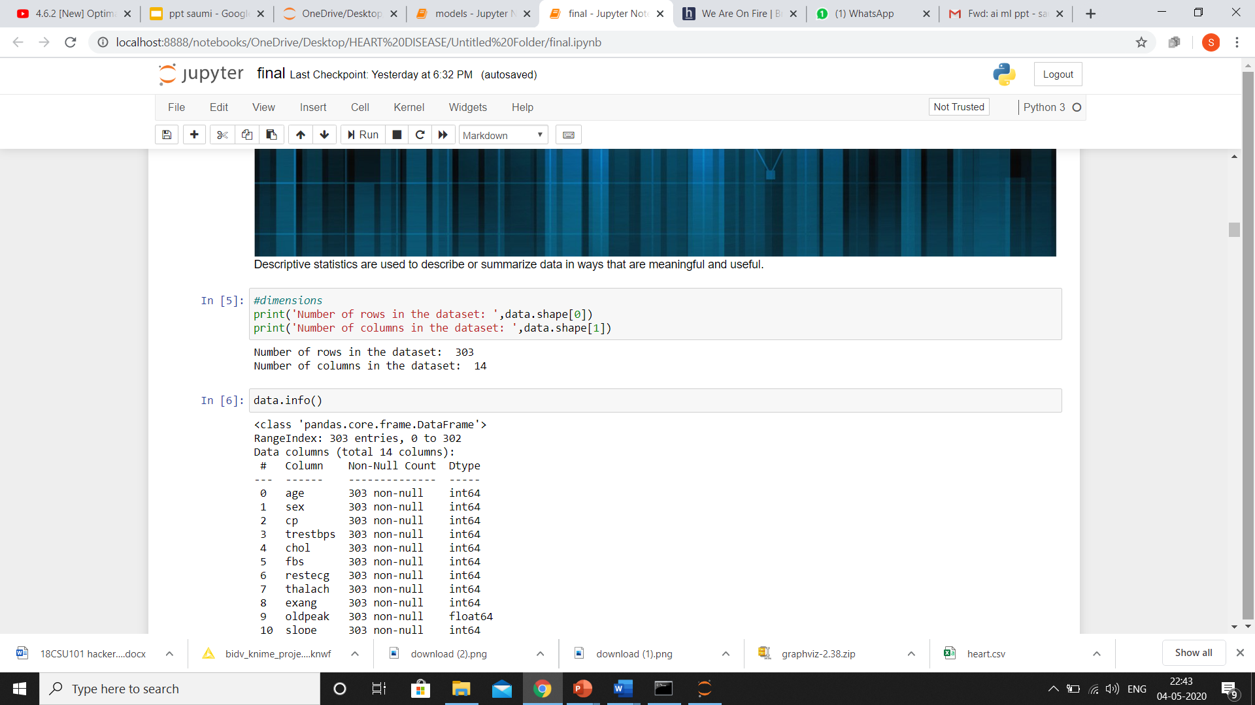
Summarising attributes
Number of unique values in each column
Checking missing values
Total number of rows and columns

Slide 6
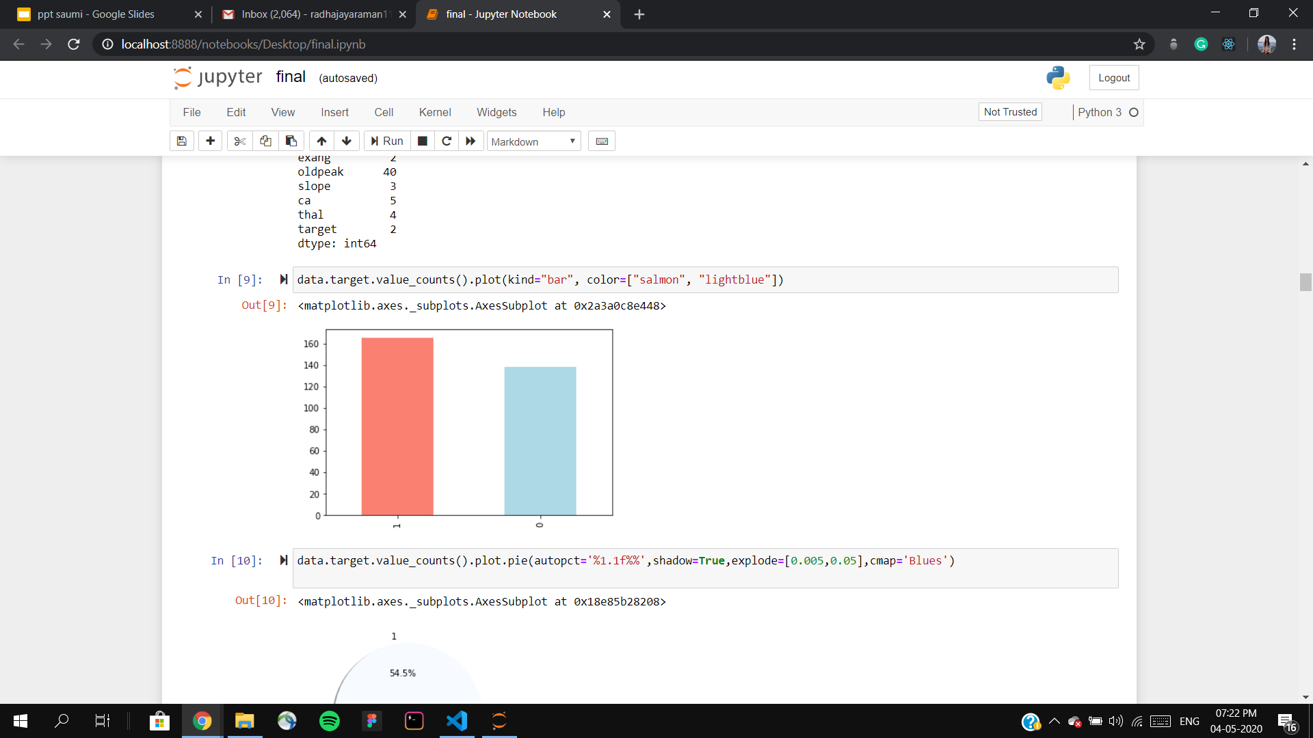
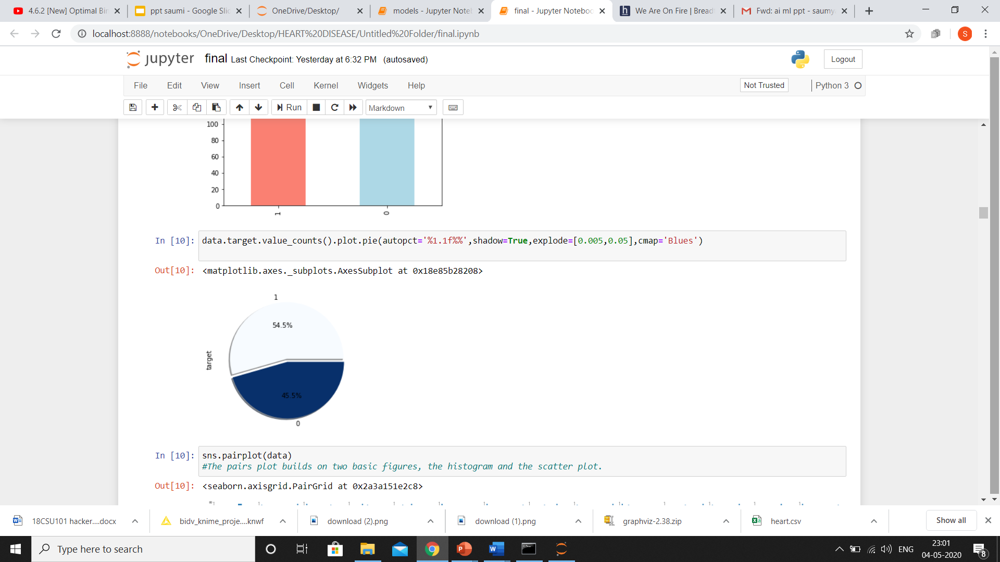
CLASS DISTRIBUTION
INFERENCE
54.5% (163 out of 303) people have heart disease .
45.5% (140 out of 303) people don’t have heart disease.
Class is unbiased since it has almost equal distribution both for presence and absence of disease.

Slide 7
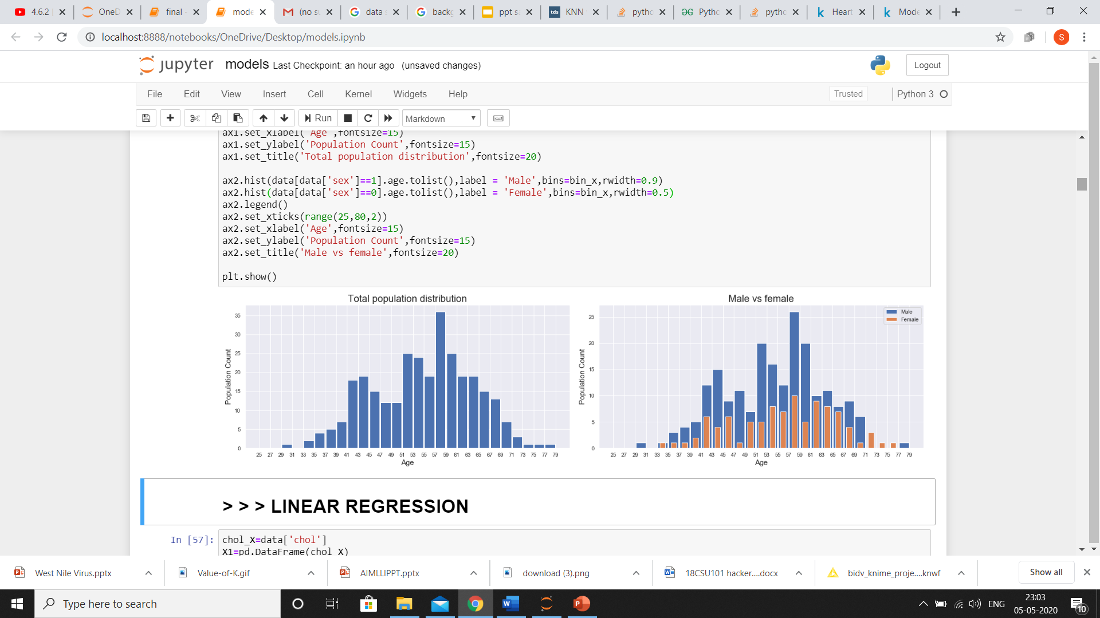
POPULATION DISTRIBUTION WITH AGE AND GENDER
Inference
Majority of people having heart disease are from age group 57-59

Slide 8
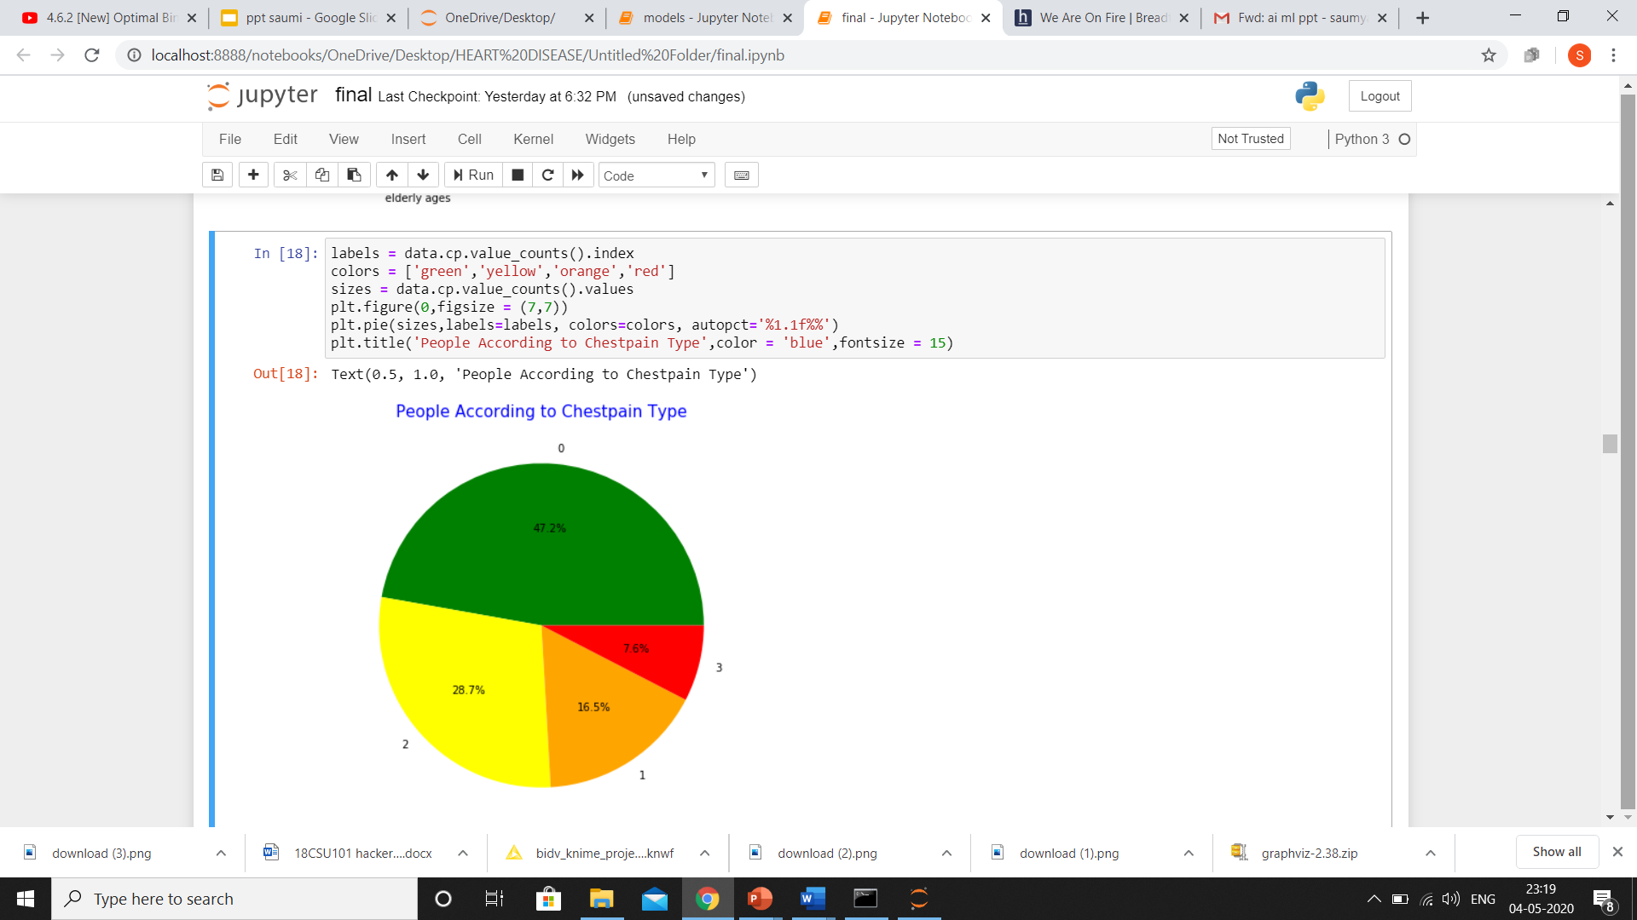
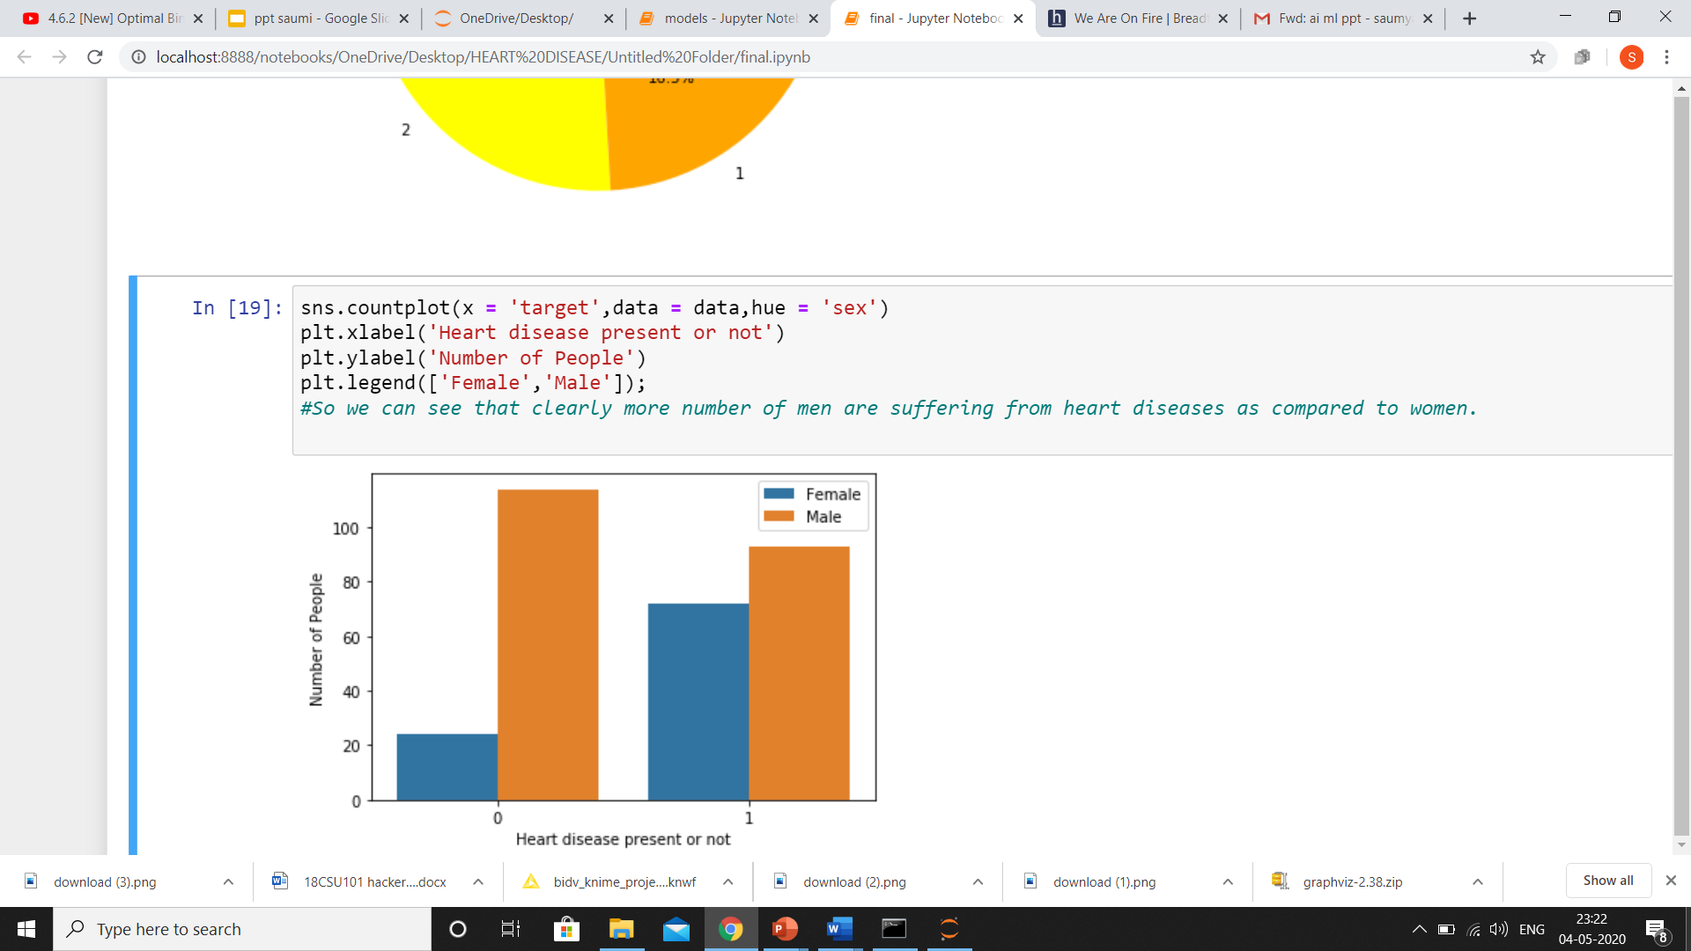
People according to chest pain type
Gender distribution wrt target
48% of people have chest pain type=0 which means normal.Whereas,around 17% have chest pain which leads to heart disease.
More number of males have heart disease as compared to females.

Slide 9
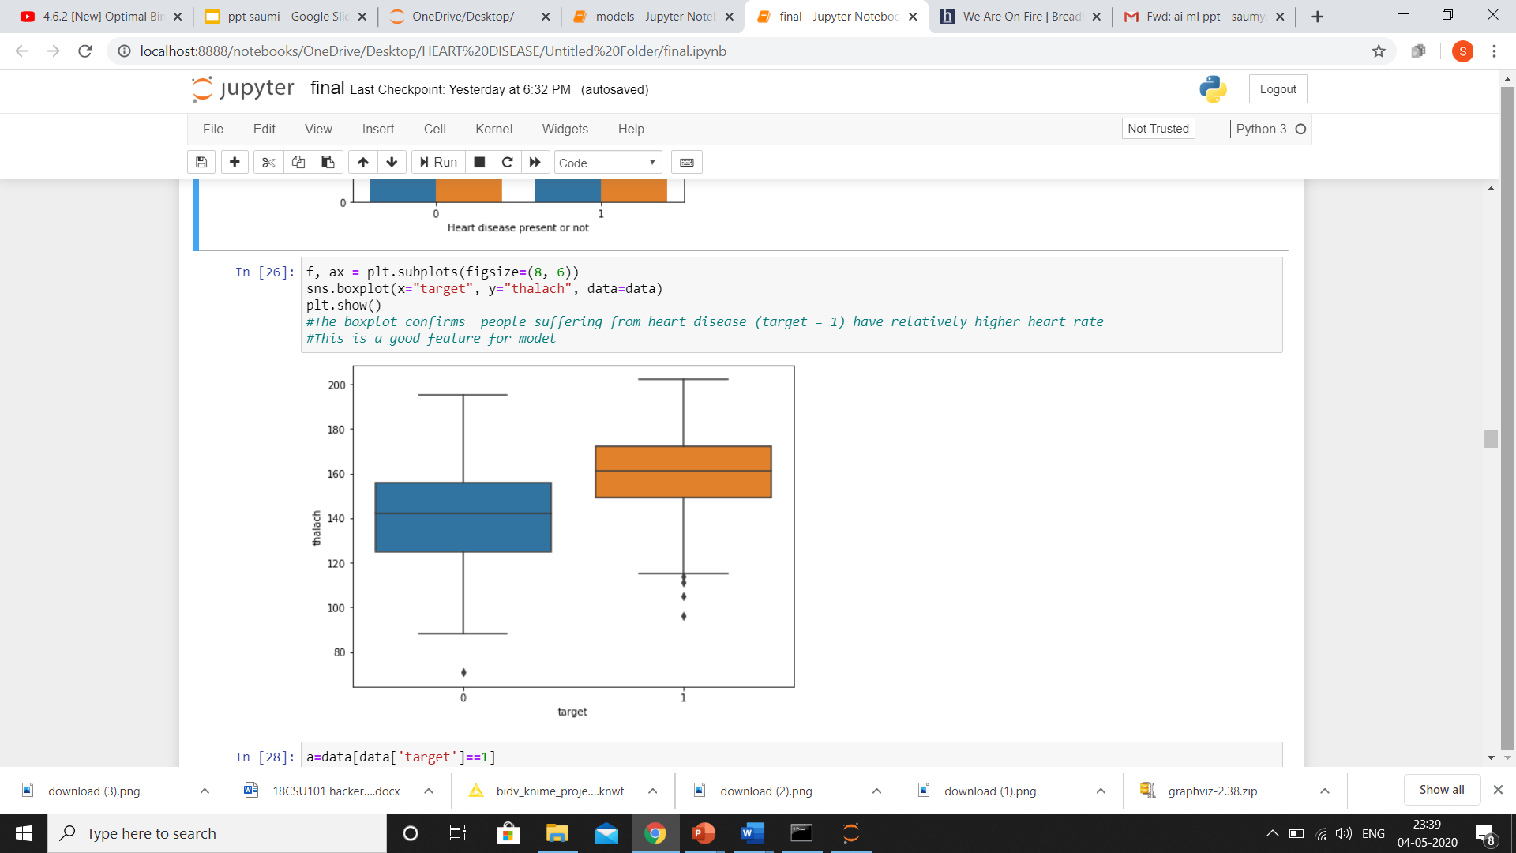
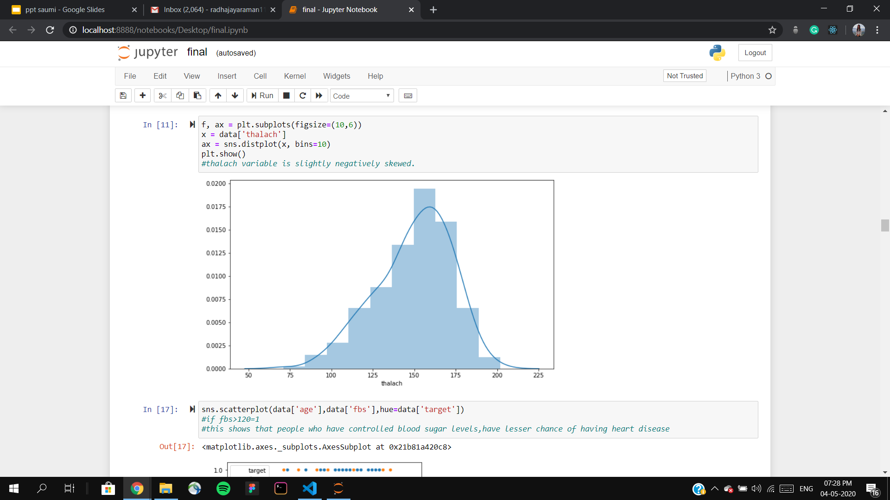
ANALYSIS OF THALACH i.e HEART RATE
Thalach wrt target
Thalach count

Slide 10
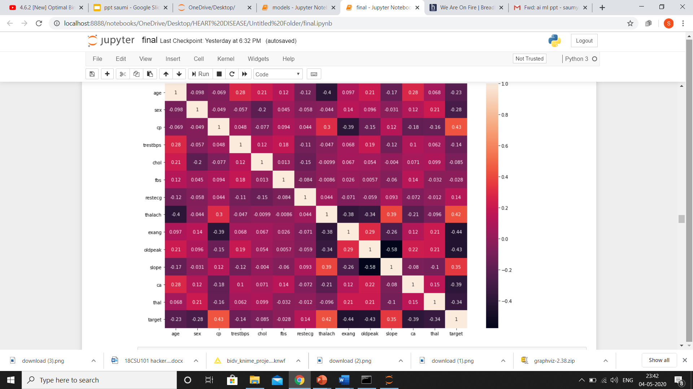
HEAT MAP
Light color signifies high correlation and dark color signifies less correlation .
Inference
Cp(chest pain) is highly correlated with target and exang is least correlated.

Slide 11
CLASSIFICATION

Slide 12
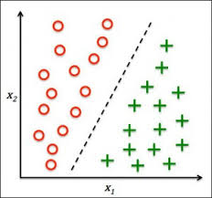
CLASSIFICATION
Classification is a supervised learning concept in machine learning, which categorizes a set of data into classes. Classes are often referred to as labels or categories. The main motive is to find in which category the new data will fall into.
For this project I have used the following classification algorithms
NAIVE BAYES
DECISION TREE
KNN
SVM

Slide 13
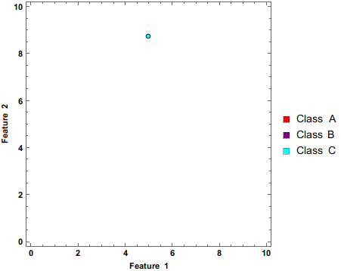
NAIVE BAYES
Naive Bayes model is based on a statistical classification technique called ‘Bayes Theorem’. Naive Bayes model are called ‘naive’ algorithms because they make an assumption that the predictor variables are independent from each other.
ADVANTAGE:
It doesn't require as much training data.
It handles both continuous and discrete data.
It is highly scalable with the number of predictors and data points.
DISADVANTAGE:
Need to calculate the prior probability;
There is an error rate in the classification decision;
Very sensitive to the form of input data;
Independence assumption might not support real time problems.
This gif can be viewed from presentation mode

Slide 14
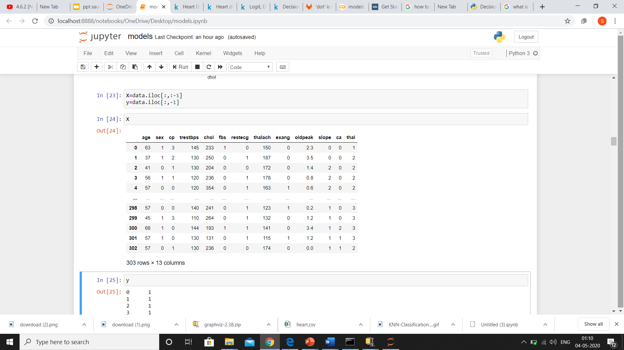
SELECTING DEPENDENT AND INDEPENDENT VARIABLE

Slide 15
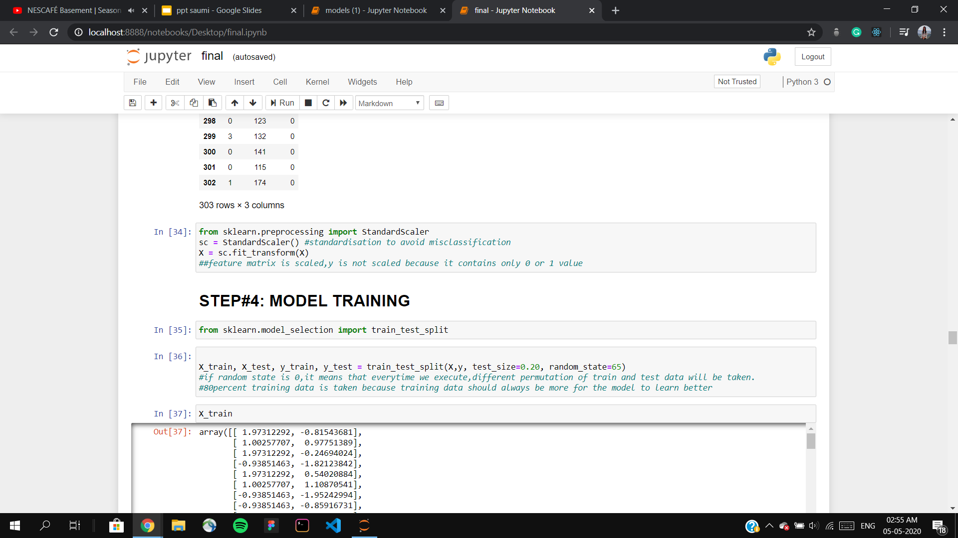
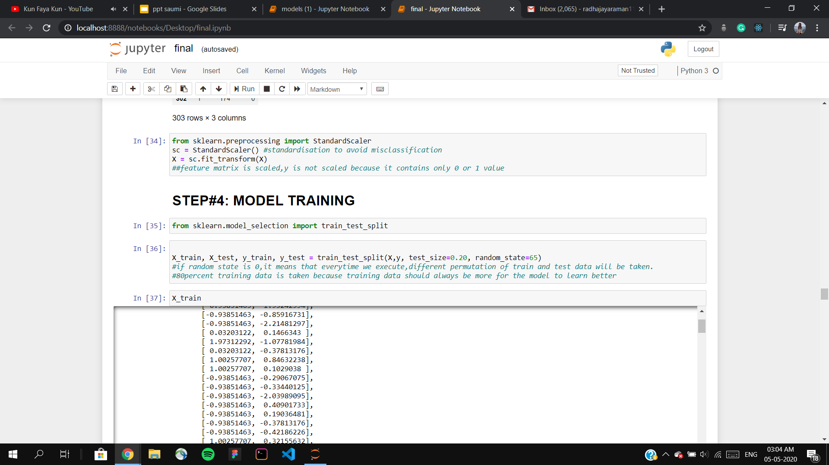
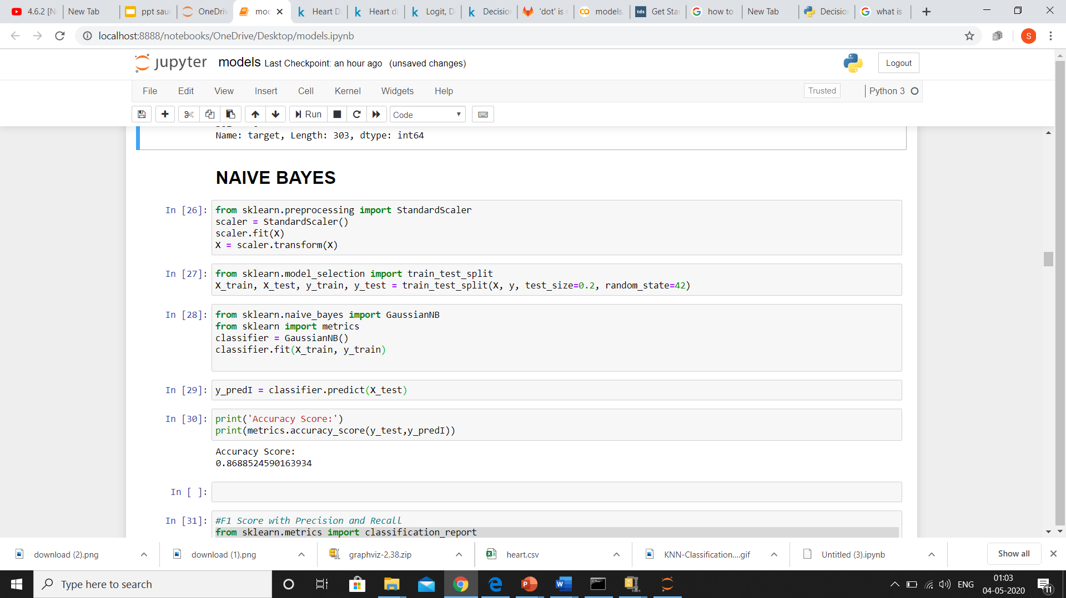
FEATURE SCALING/STANDARDISATION
Brings all independent variables on a common scale.
SPLITTING DATA INTO TRAINING SET AND TEST SET
Partitioning data into train set (80%) and test set(20%).
TRAINING MODEL
Fitting object named classifier of naive bayes model on the training set.
STORING PREDICTION OF Y FROM X_TEST
Predicting values of X from test set data.

Slide 16
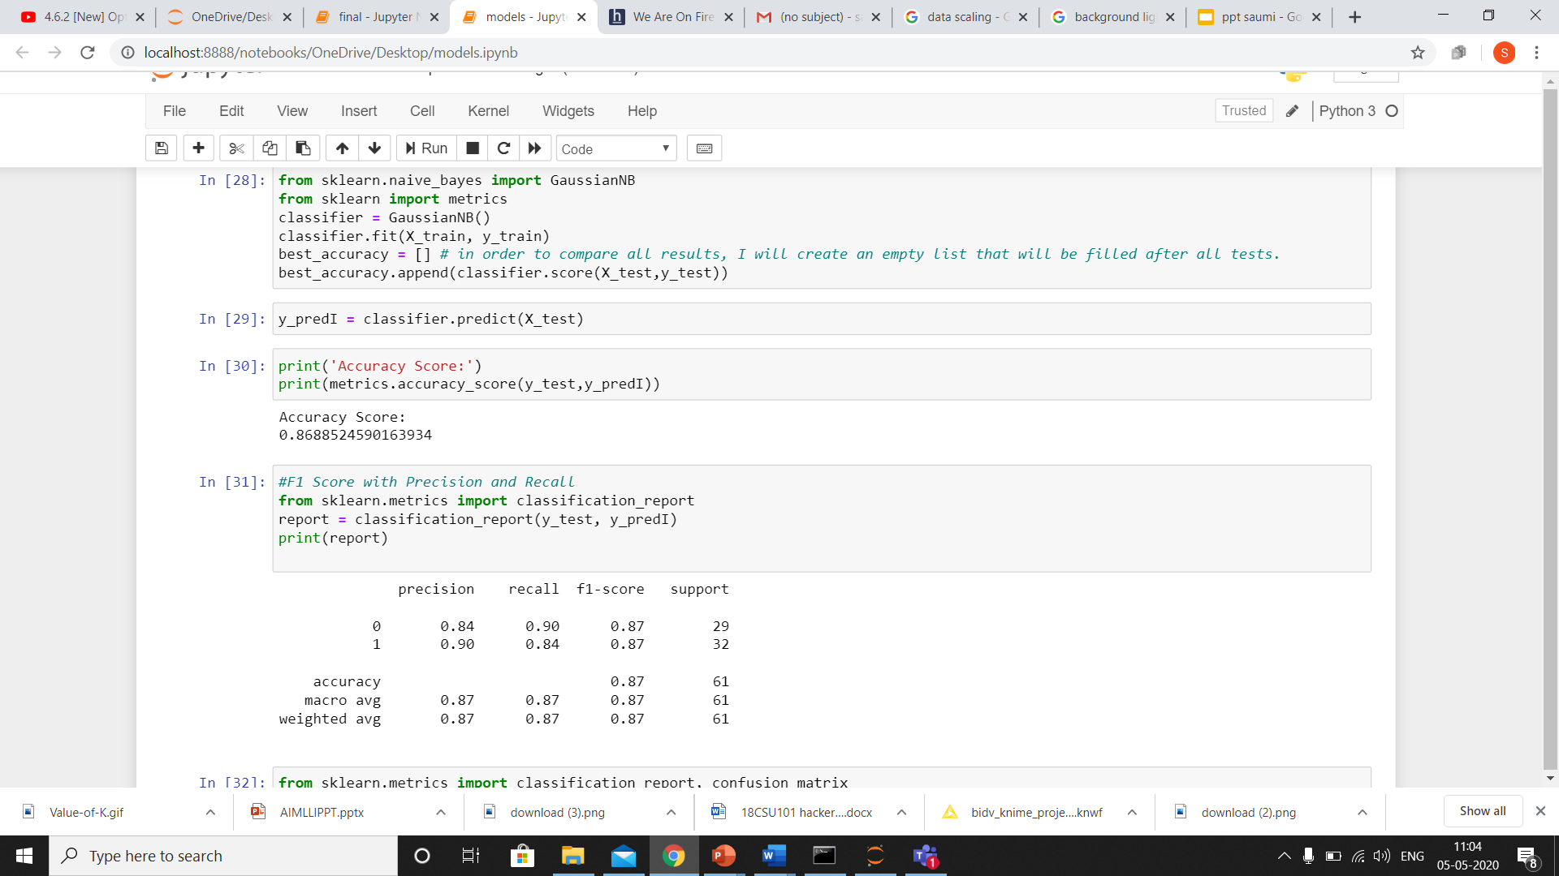
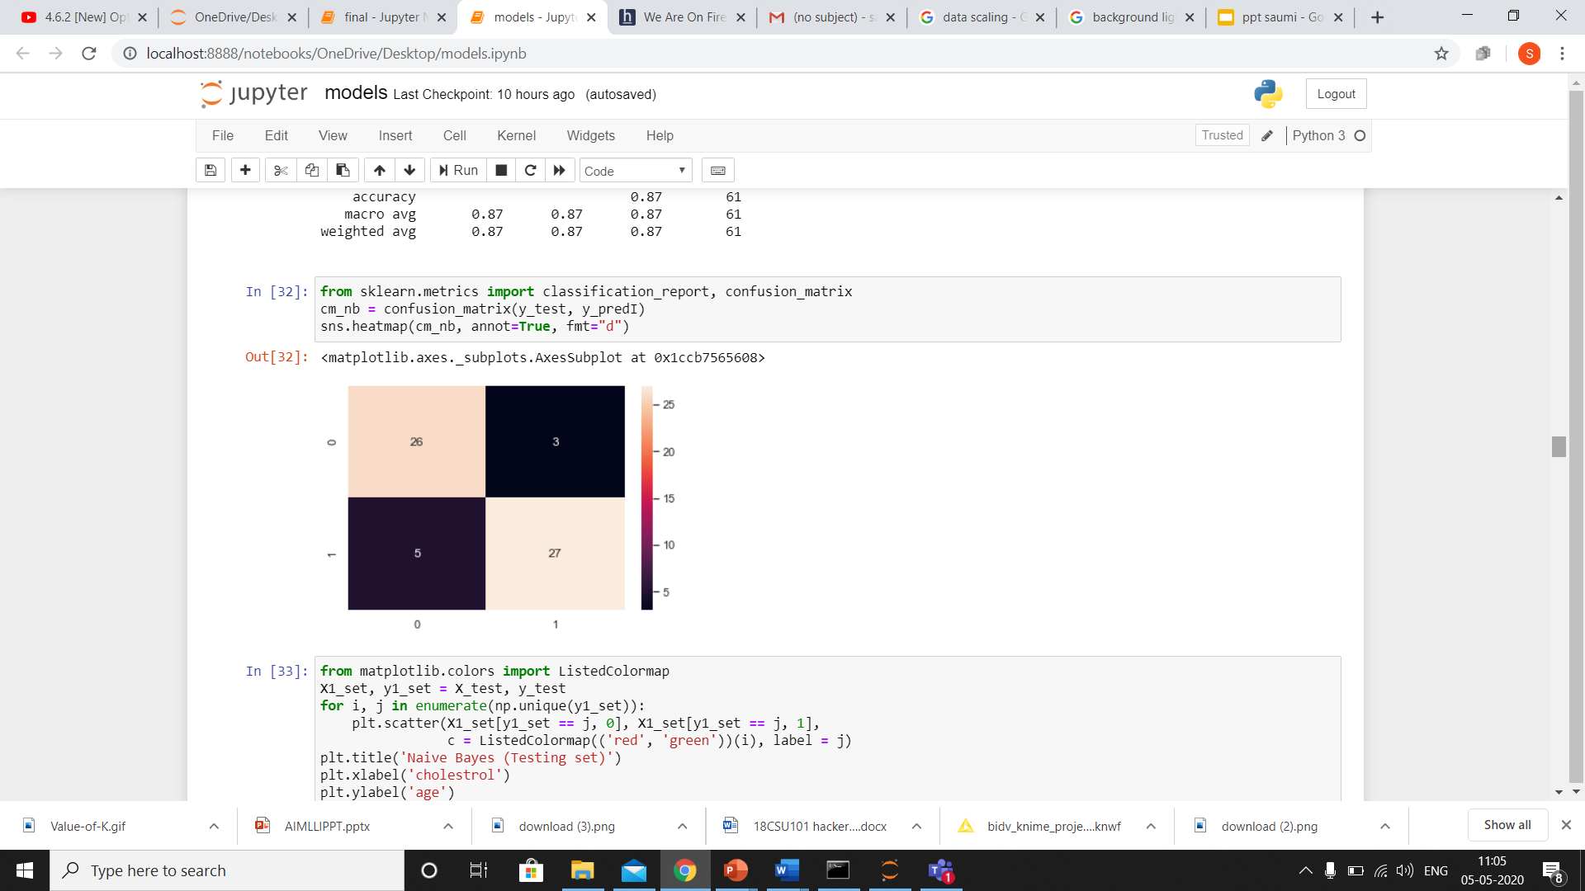
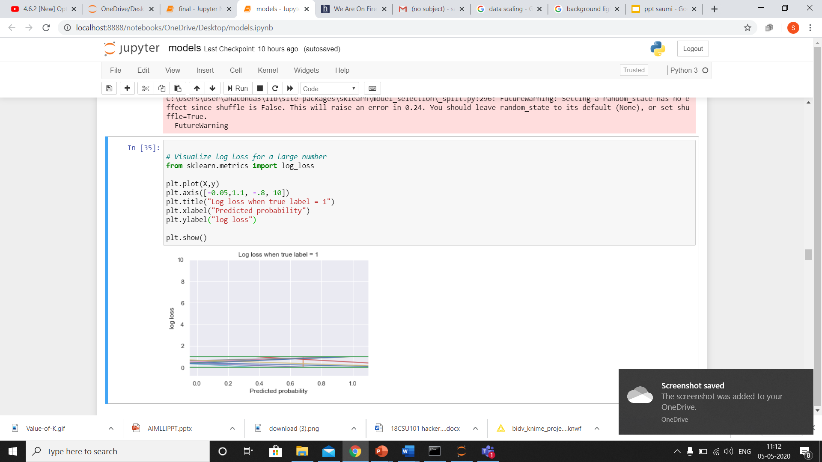
PERFORMANCE MEASURES
CLASSIFICATION REPORT
CONFUSION MATRIX
LOG LOSS

Slide 17
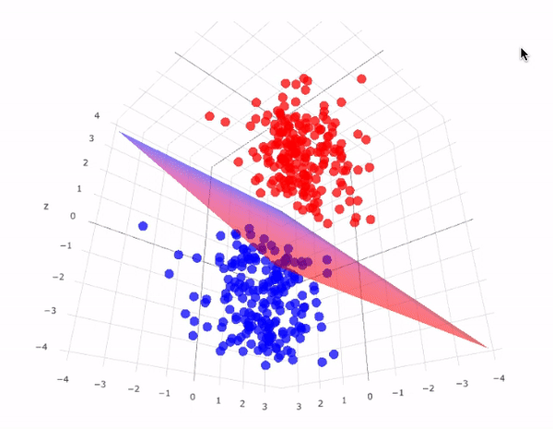
SUPPORT VECTOR MACHINE
The objective of the SVM algorithm is to find a hyperplane in an N-dimensional space(N — the no. of features) that distinctly classifies the data points.Our objective is to find a plane that has the maximum distance between data points of both classes.
ADVANTAGES:
SVM’s are very good when we have no idea on the data.
Works well with even unstructured and semi structured data like text, Images and trees.
The kernel trick is real strength of SVM. With an appropriate kernel function, we can solve any complex problem.
It scales relatively well to high dimensional data.
Risk of over-fitting is less in SVM.
DISADVANTAGES:
Choosing a “good” kernel function is not easy.
Long training time for large datasets.
Difficult to understand and interpret the final model, variable weights and individual impact.
The SVM hyper parameters are Cost -C and gamma. It is not that easy to fine-tune these hyper-parameters. It is hard to visualize their impact
This gif can be viewed from presentation mode

Slide 18
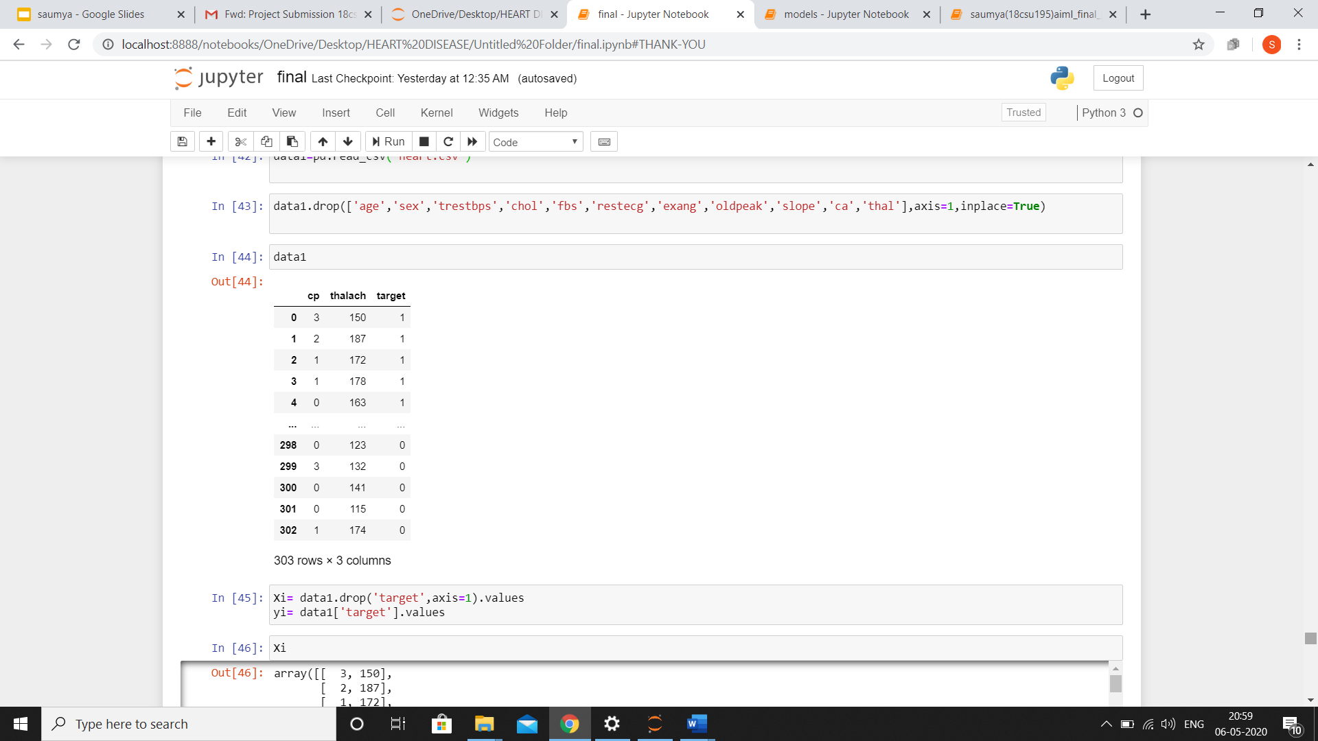
DROPPING COLUMNS FOR SVM MODEL

Slide 19
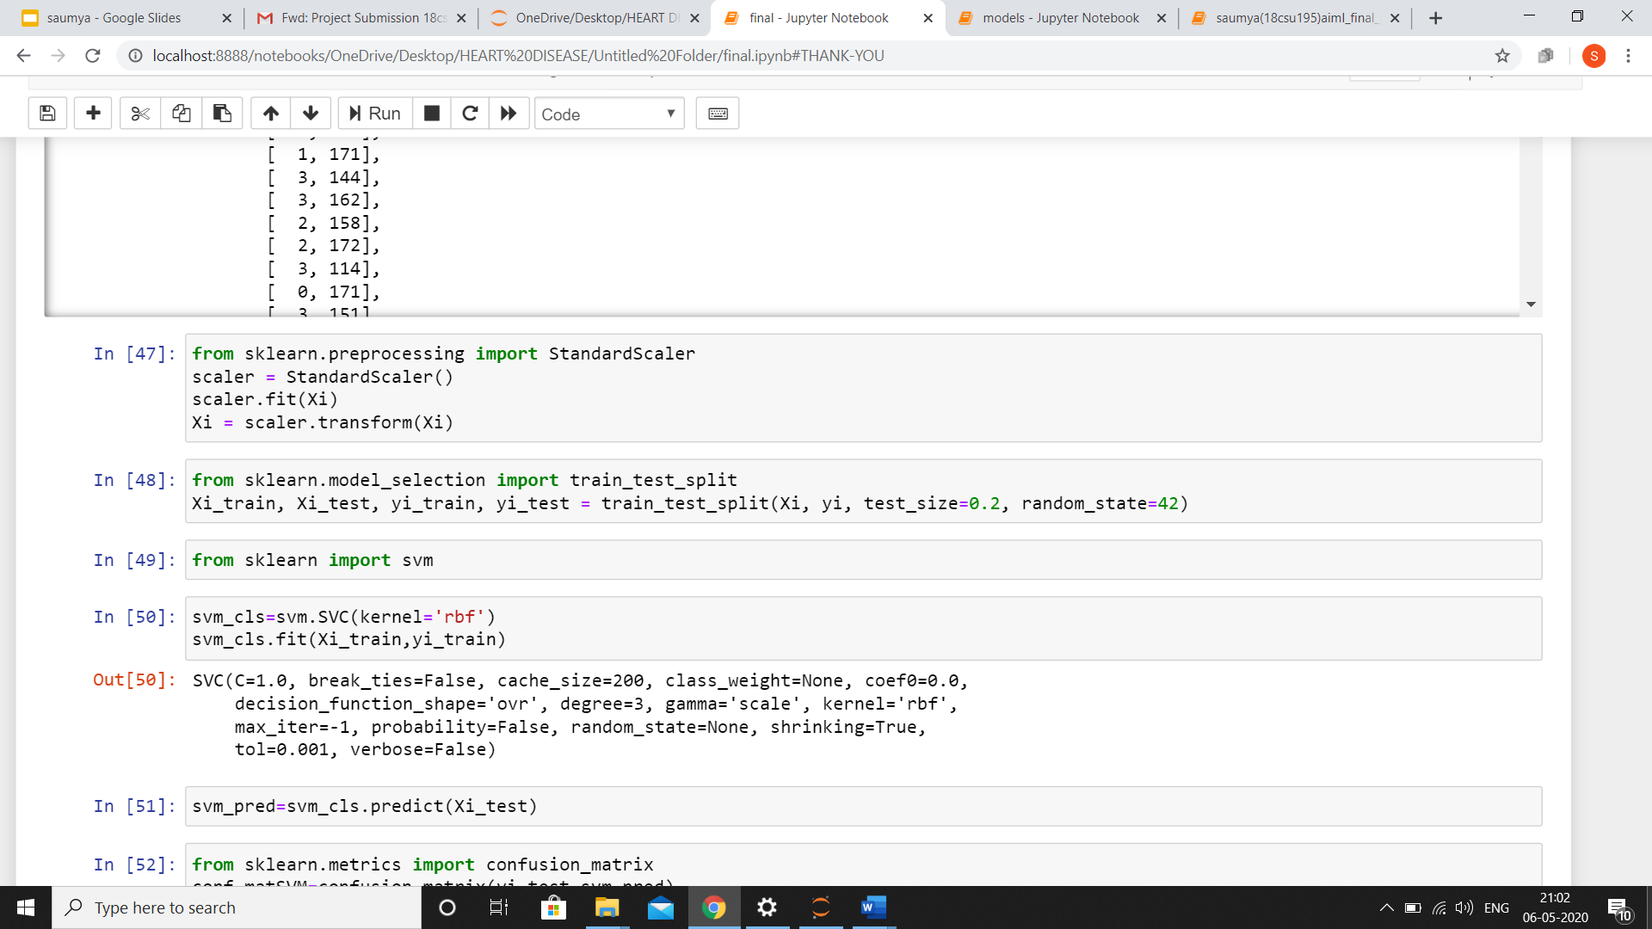

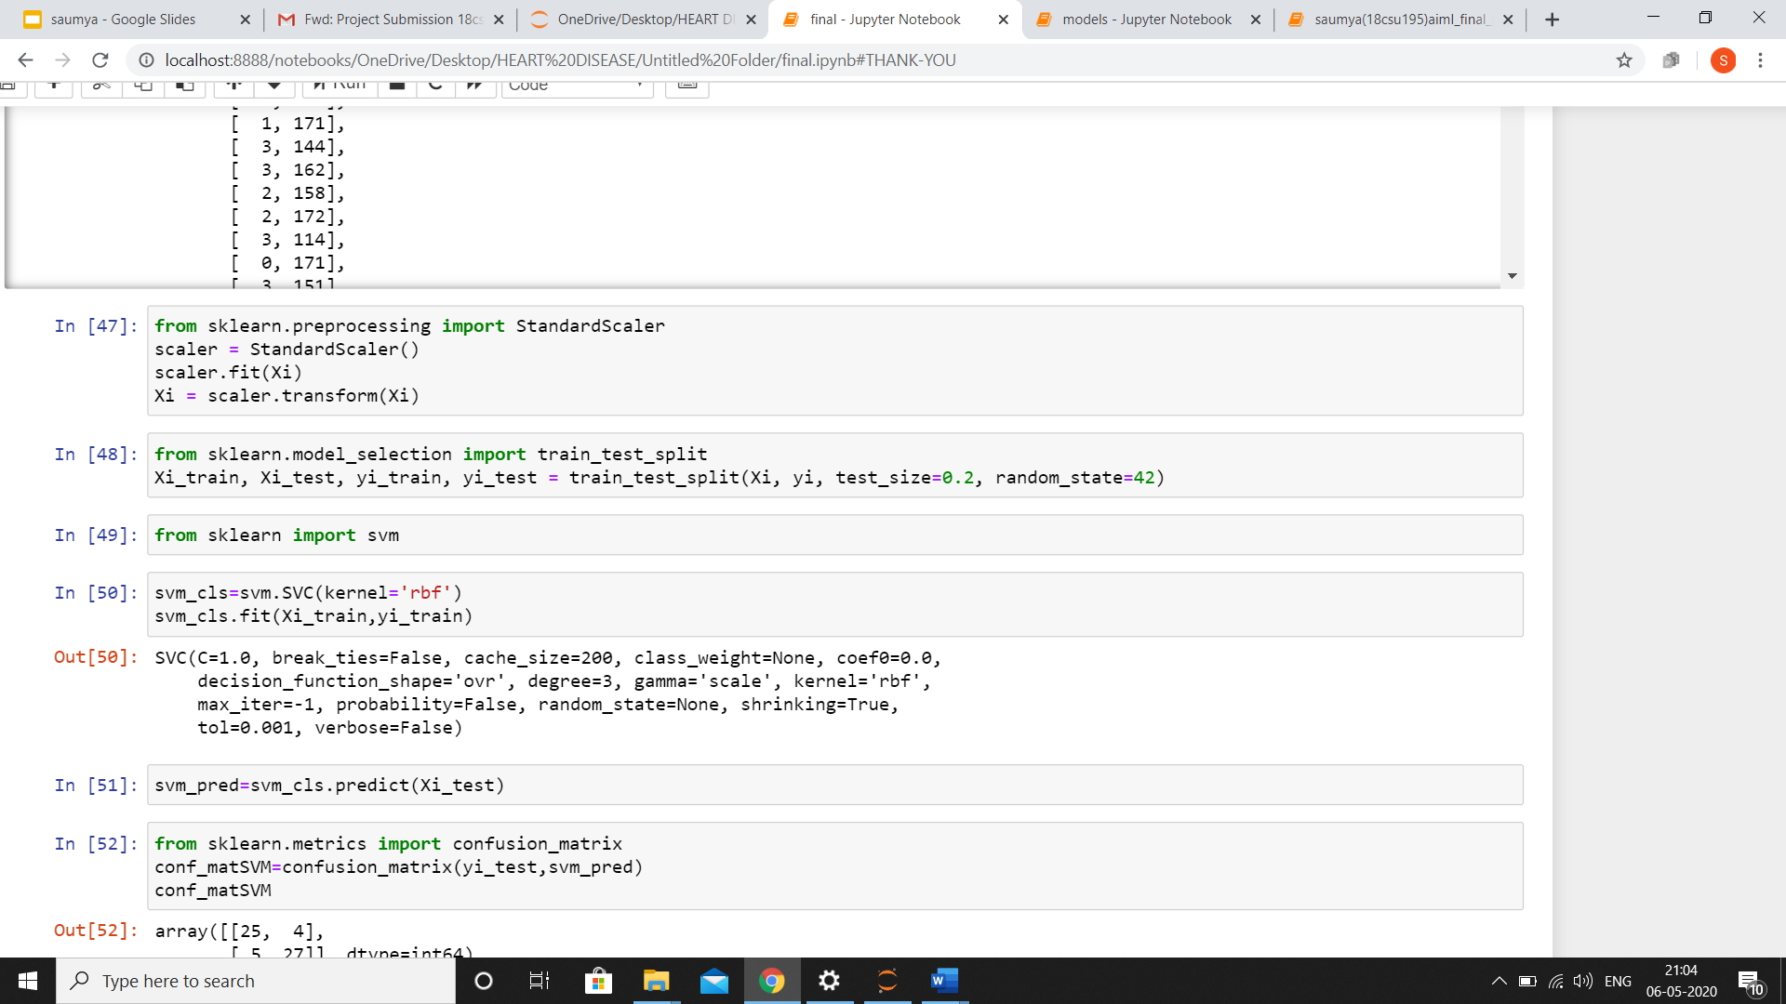
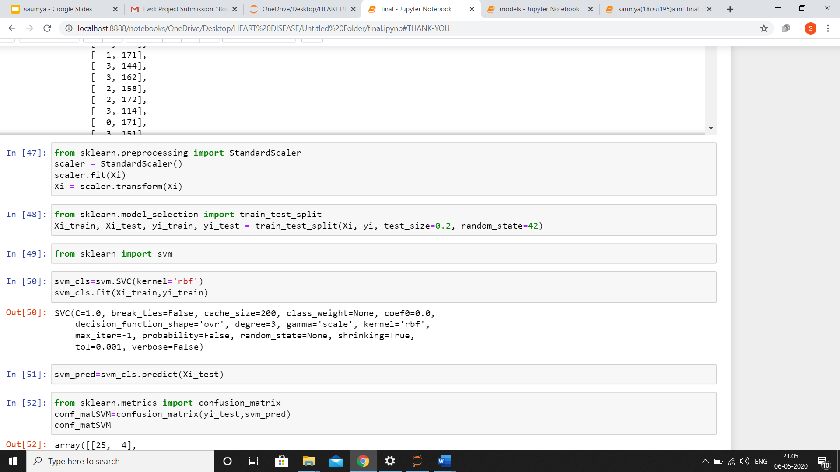
FEATURE SCALING/STANDARDISATION
Brings all independent variables on a common scale.
SPLITTING DATA INTO TRAINING SET AND TEST SET
Partitioning data into train set (80%) and test set(20%).
TRAINING MODEL
Fitting object named classifier of knn on the training set.
STORING PREDICTION OF Y FROM X_TEST
Predicting values of X from test set data.

Slide 20
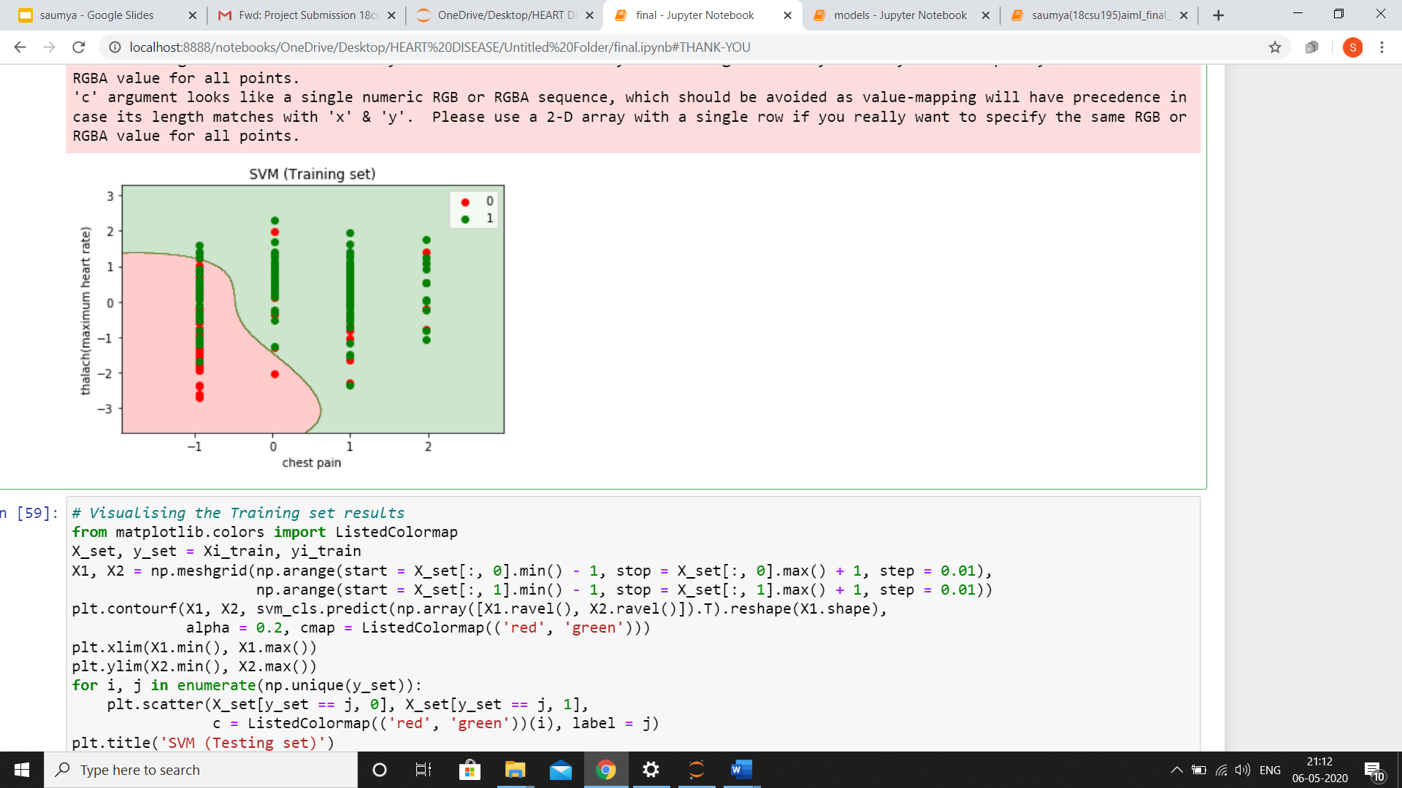
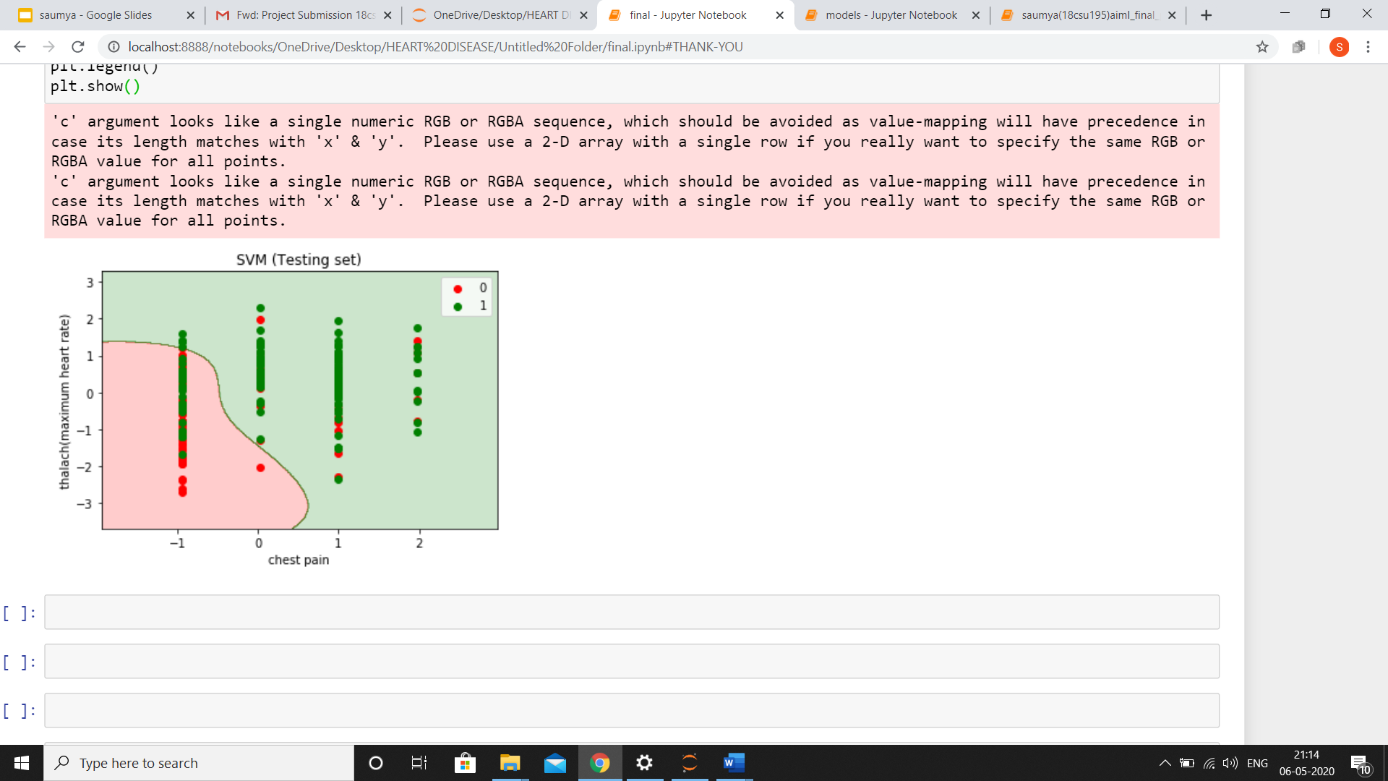
TRAINING AND TESTING SET VISUALISATION

Slide 21
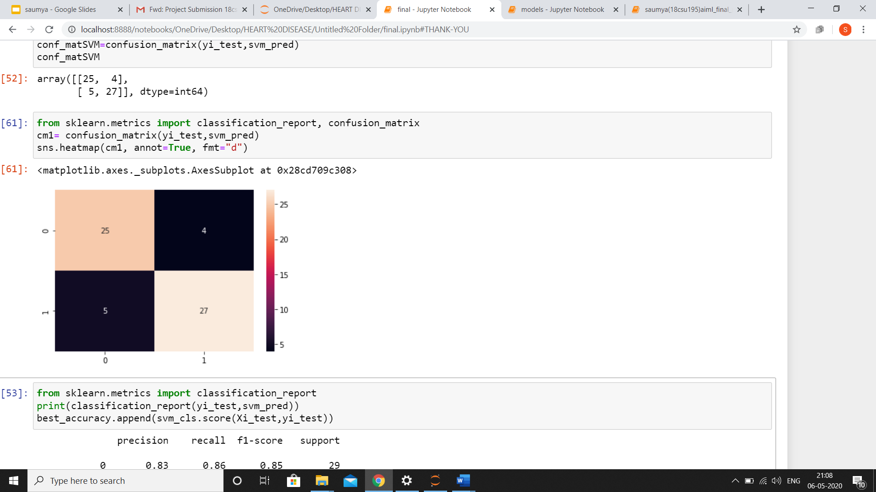
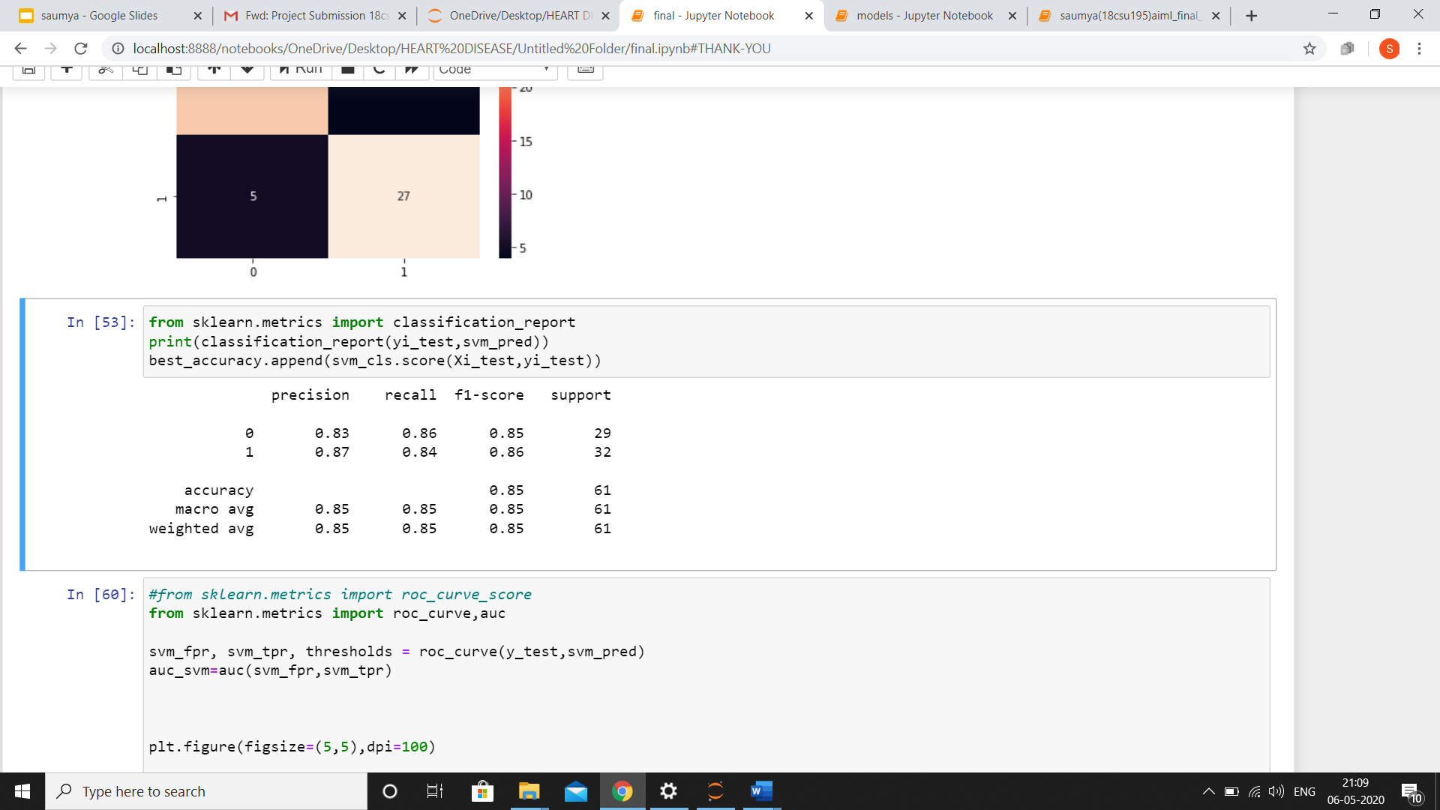
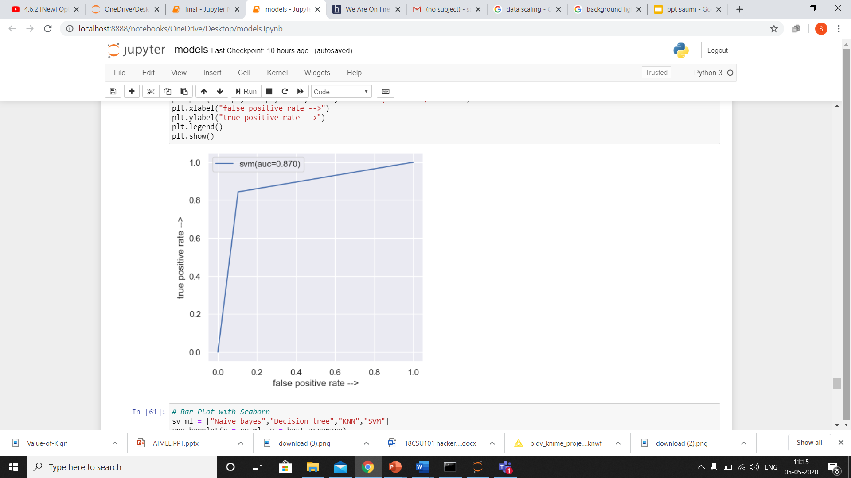
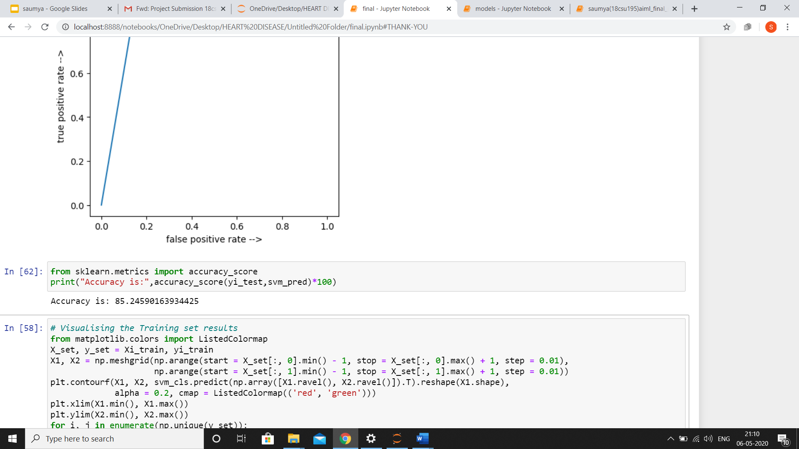
PERFORMANCE MEASURES
CONFUSION MATRIX
CLASSIFICATION REPORT
AREA UNDER CURVE
ACCURACY

Slide 22
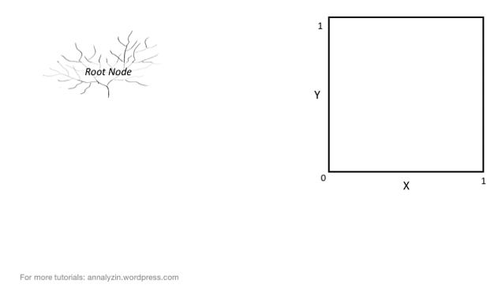
DECISION TREE
The data is continuously split according to a certain parameter. In case of classification, the decision parameter is discrete/categorical.The splitting is stopped when we have largest information gain.
ADVANTAGE:
Inexpensive to construct and extremely fast
Prunes unimportant features.
DISADVANTAGE:
Easy to overfit.
Small changes in the training data can result in large changes
to decision logic.
This gif can be viewed from presentation mode

Slide 23
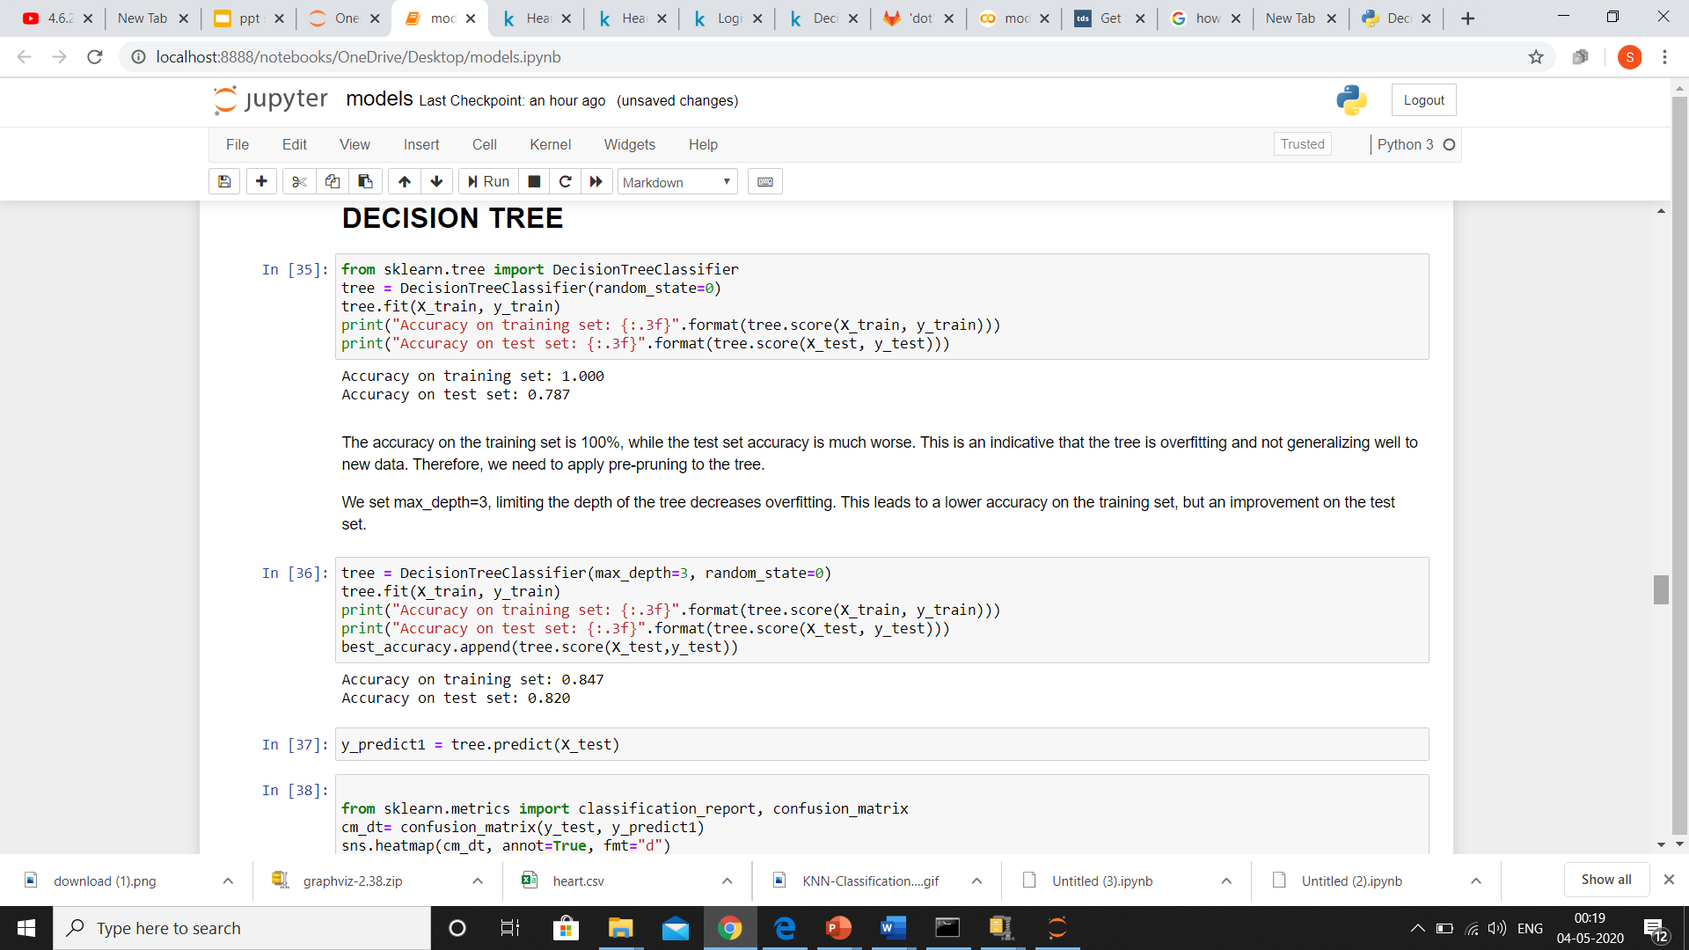
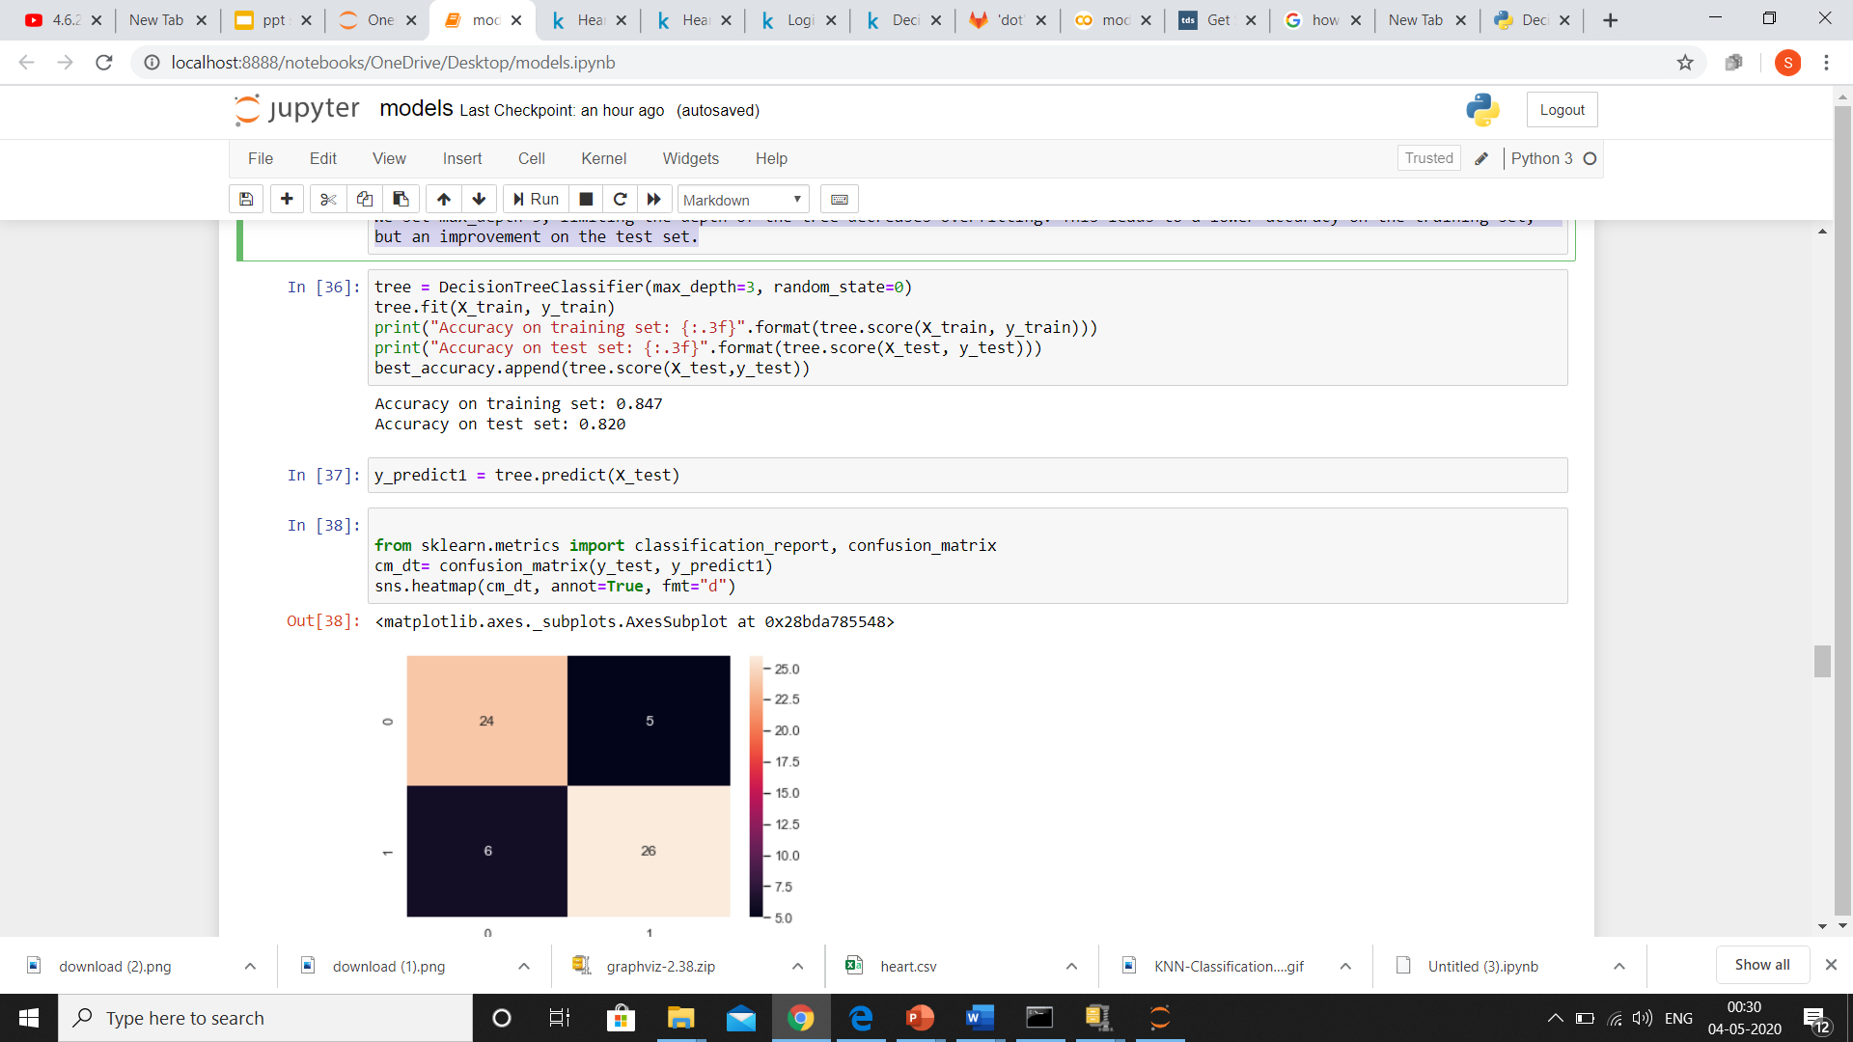
FITTING DECISION TREE MODEL AND CHECKING ACCURACY
This is an indicative that the tree is overfitting and not generalizing well to new data.
Therefore, we need to apply pre-pruning to the tree

Slide 24
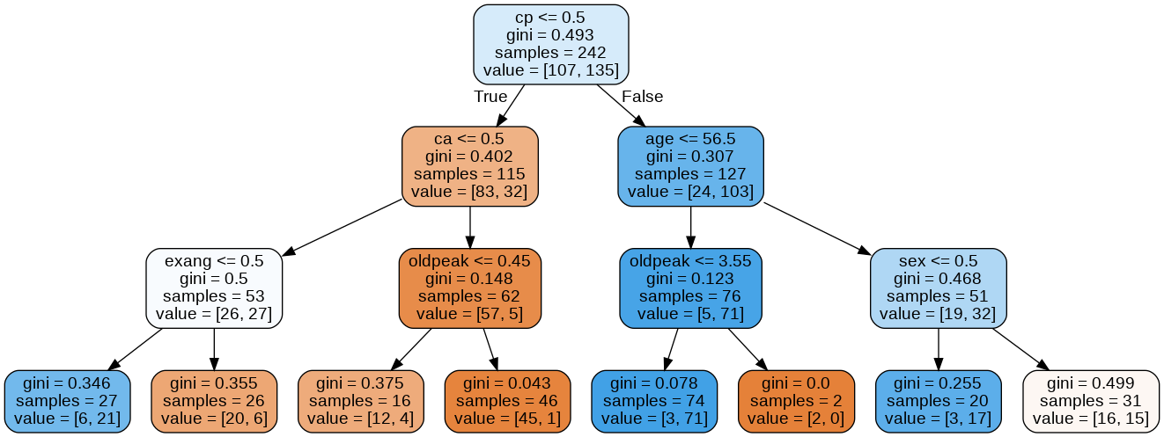
TREE GENERATED

Slide 25
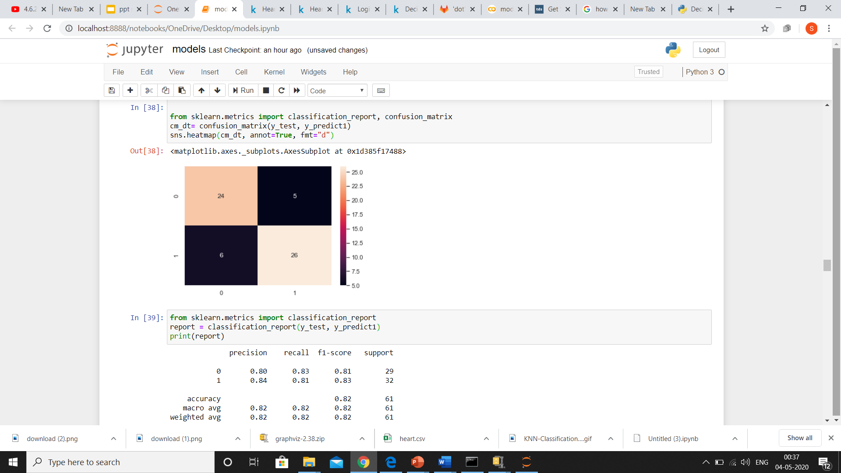
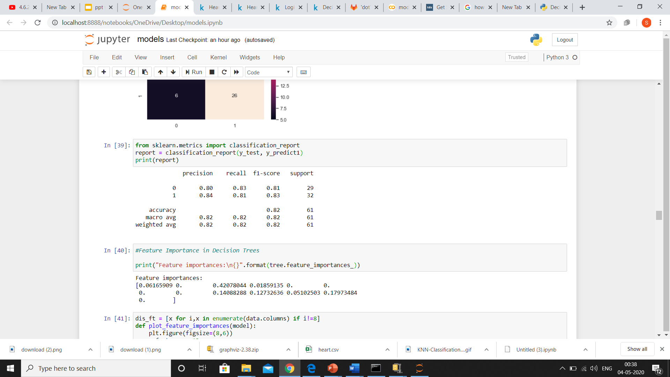
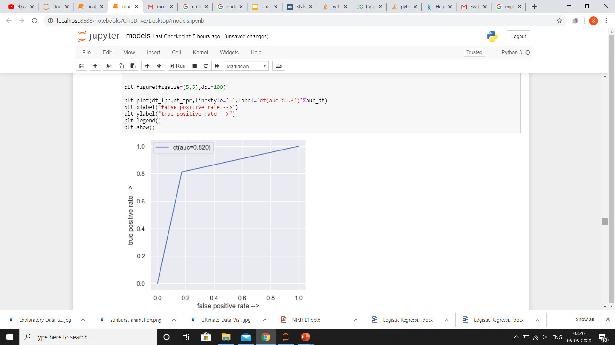
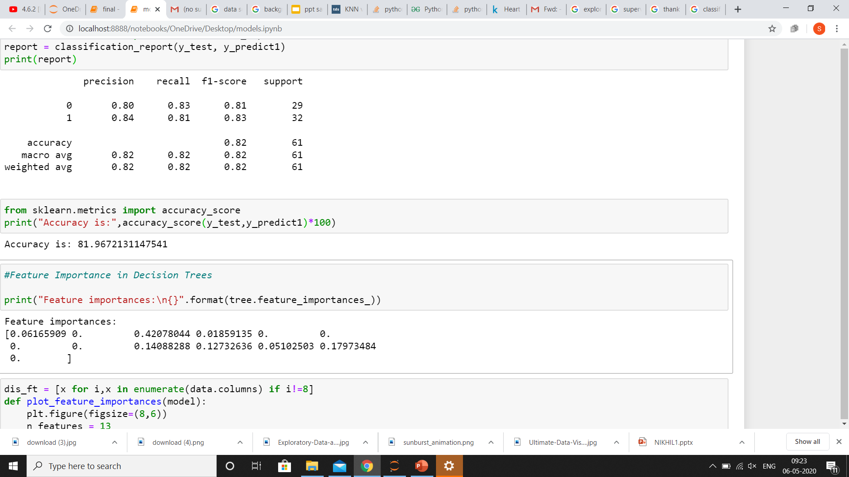
PERFORMANCE MEASURES
CONFUSION MATRIX
CLASSIFICATION REPORT
AREA UNDER CURVE
ACCURACY

Slide 26
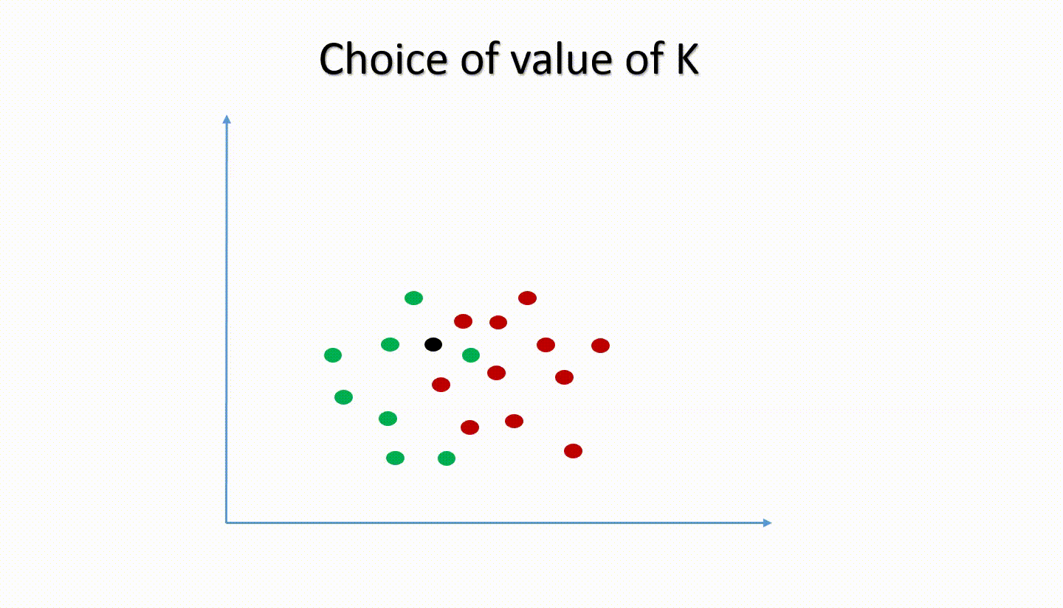
K NEAREST NEIGHBOUR
The KNN algorithm assumes that similar things exist in close proximity. In other words, similar things are near to each other i.e analogous to distance. Euclidian distance is a popular choice for calculation of distances.
ADVANTAGE:
The algorithm is simple and easy to implement.
There’s no need to build a model, tune several
parameters, or make additional assumptions.
DISADVANTAGE:
The algorithm gets significantly slower as the number
of examples and/or predictors/independent variables
increase.

Slide 27
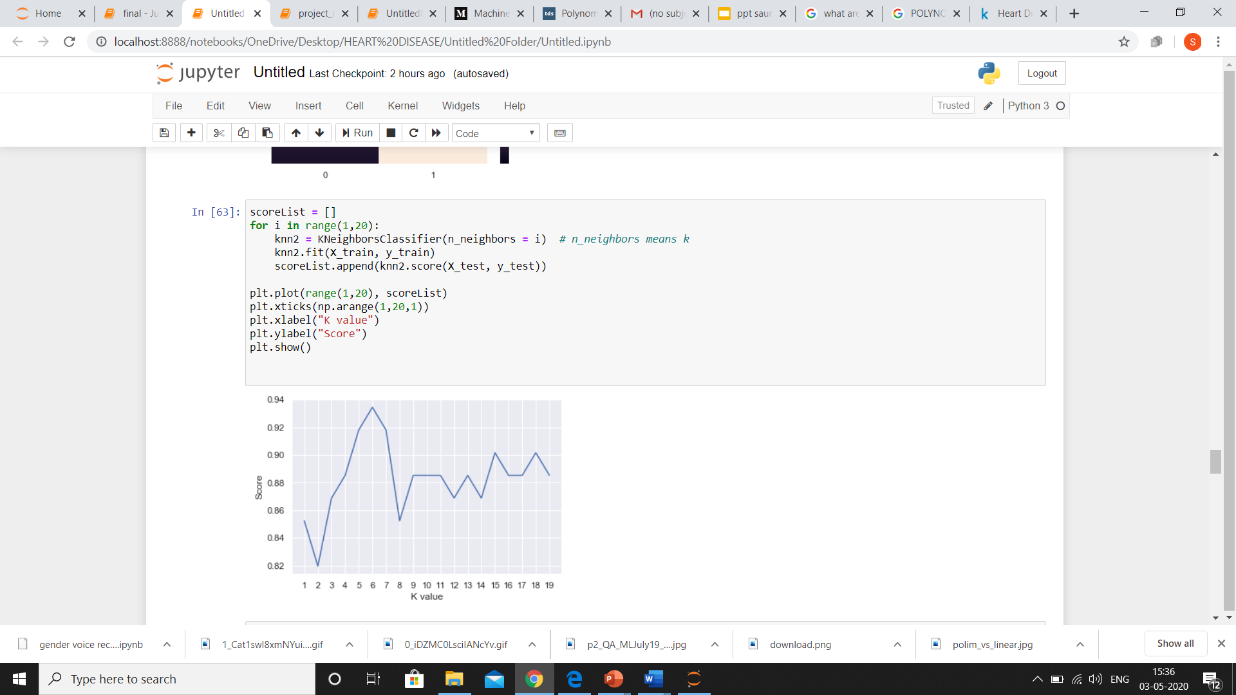
WHICH K VALUE GIVES THE BEST ACCURACY?

Slide 28
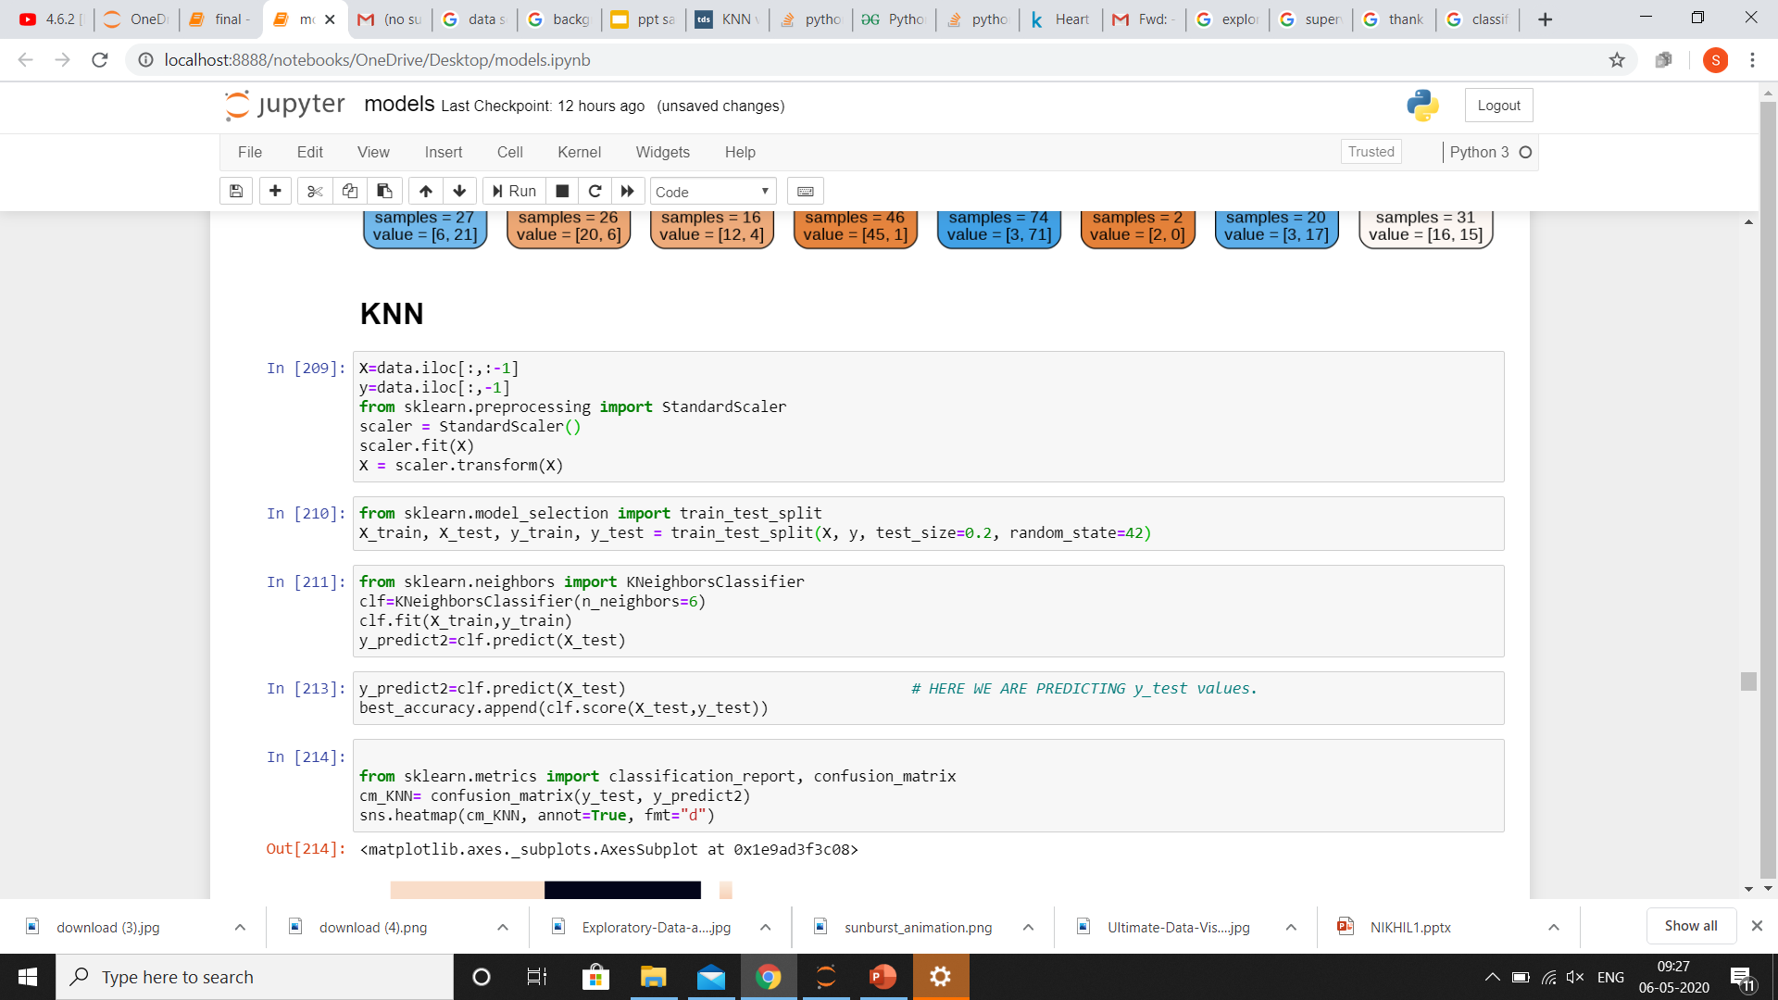
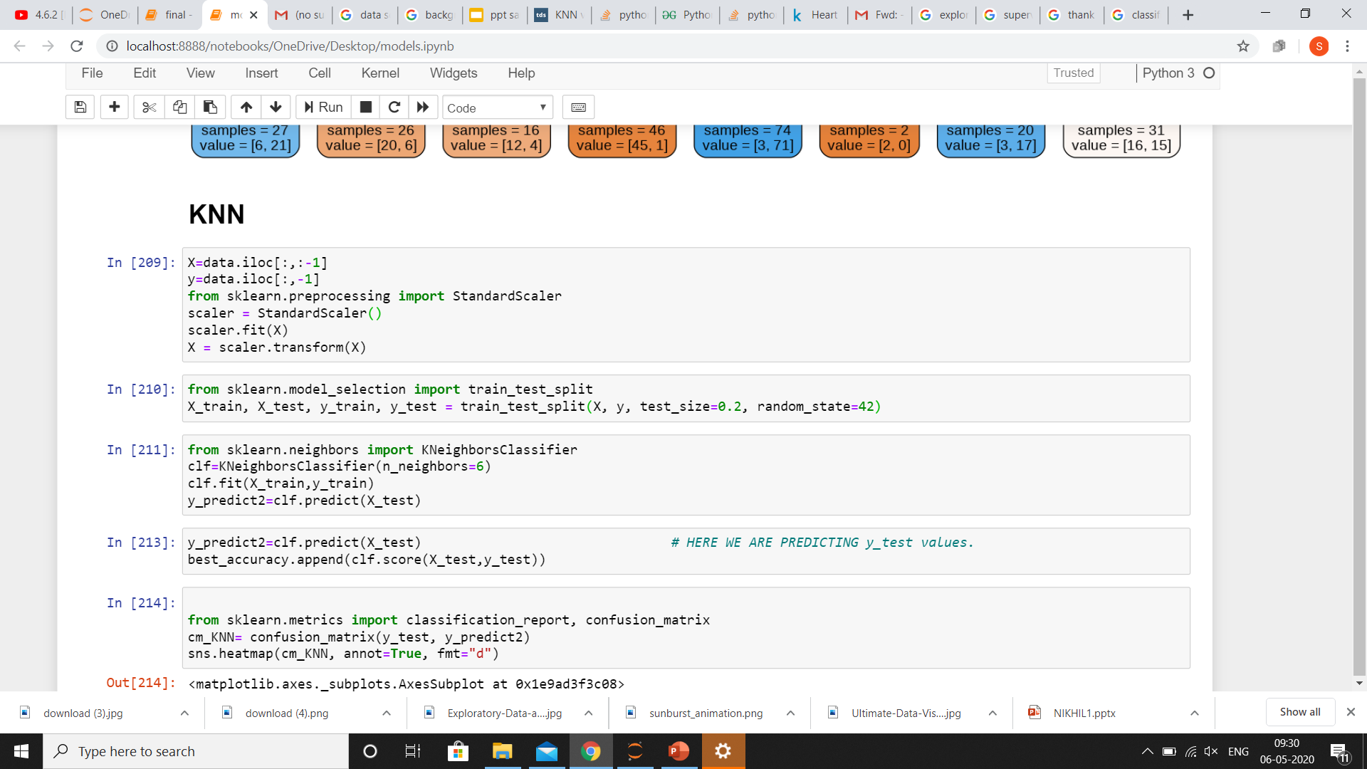
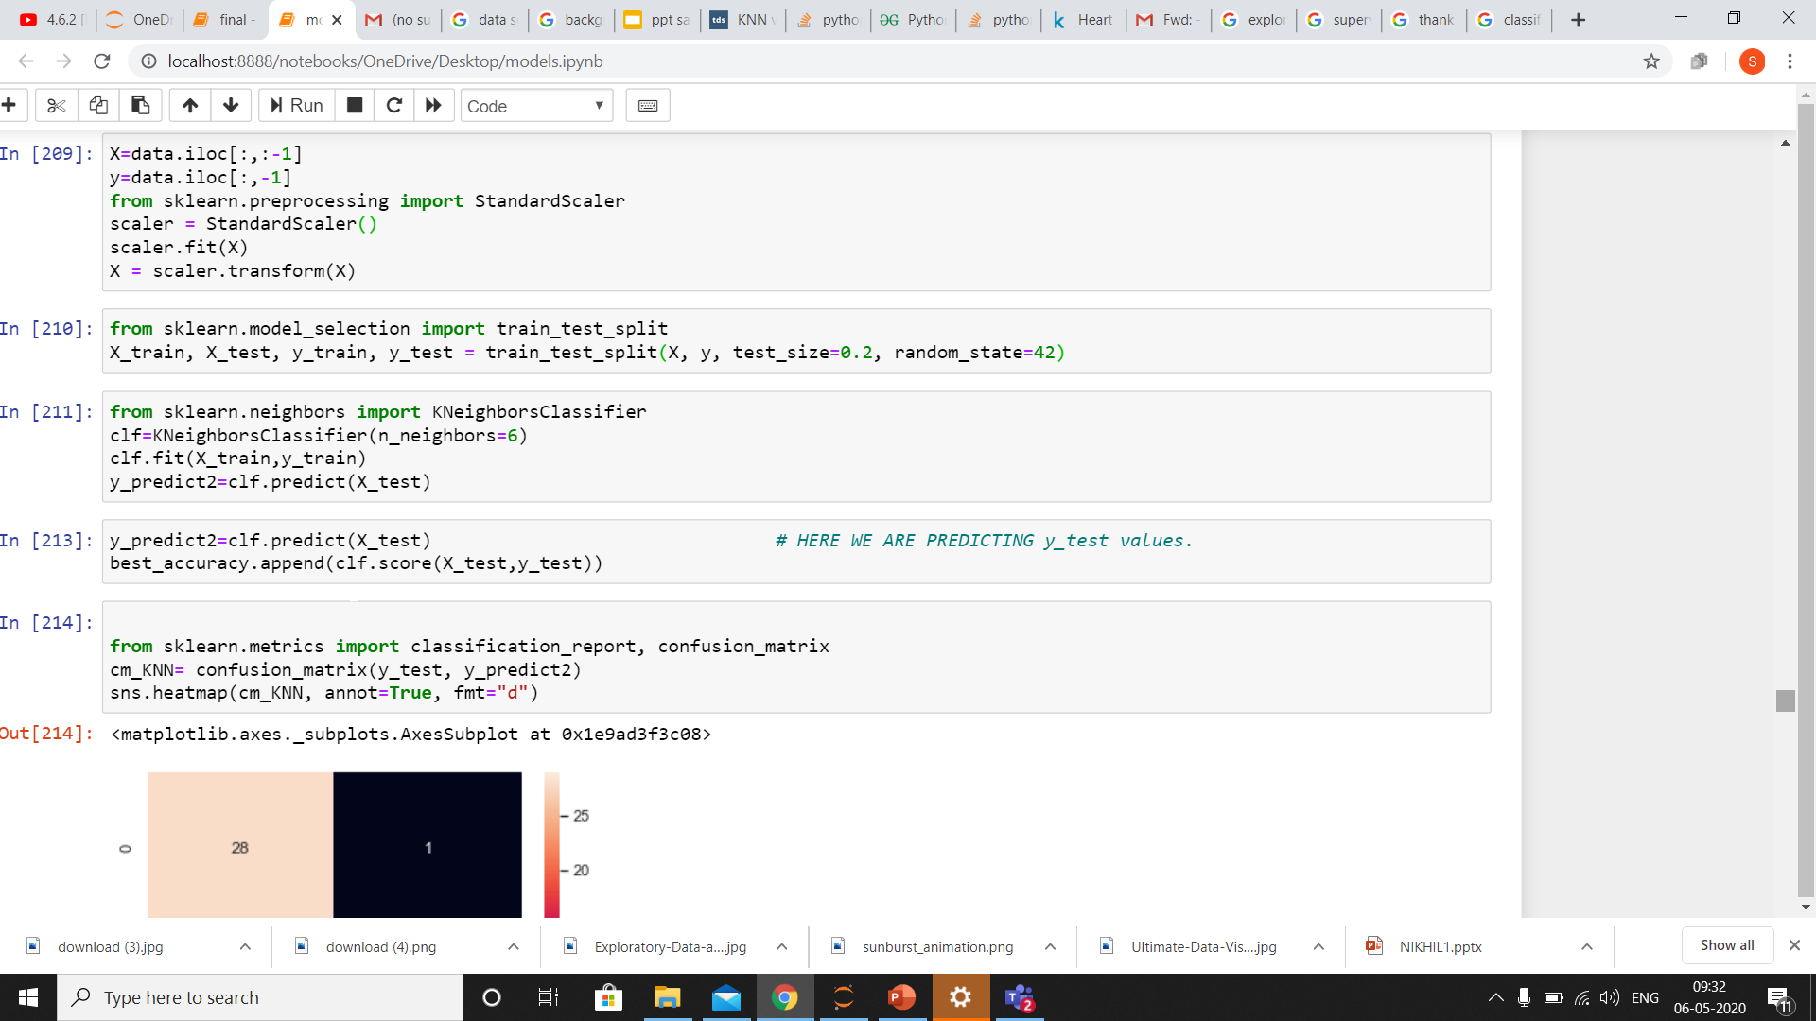
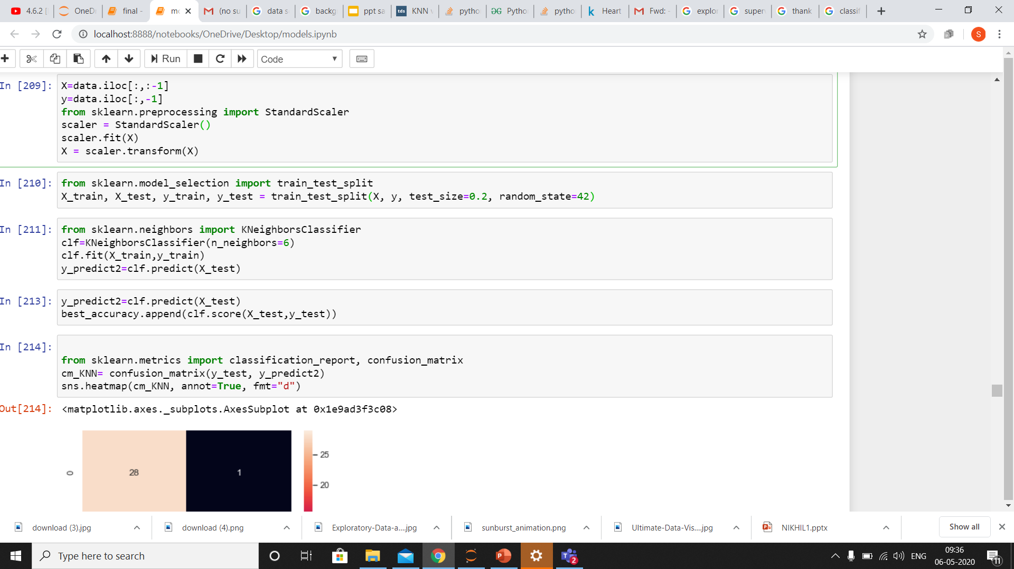
FEATURE SCALING/STANDARDISATION
Brings all independent variables on a common scale.
SPLITTING DATA INTO TRAINING SET AND TEST SET
Partitioning data into train set (80%) and test set(20%).
TRAINING MODEL
Fitting object named classifier of knn on the training set.
STORING PREDICTION OF Y FROM X_TEST
Predicting values of X from test set data.

Slide 29
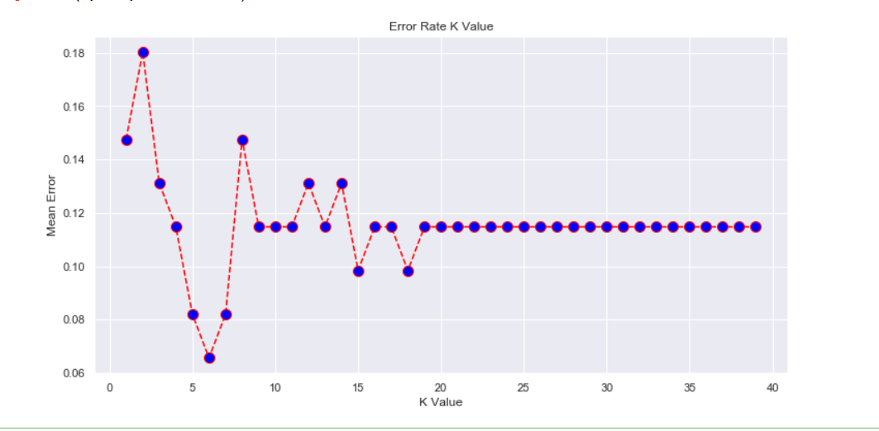
ERROR RATE
Error rate is calculated as the number of all incorrect predictions divided by the total number of the dataset.

Slide 30




PERFORMANCE MEASURES
CONFUSION MATRIX
AREA UNDER CURVE
CLASSIFICATION REPORT
ACCURACY

Slide 31
REGRESSION

Slide 32
REGRESSION
Regression is a statistical approach to find the relationship between variables used to predict the outcome of an event based on the relationship between variables obtained from the data-set.
For this project I have used the following three regression techniques:-
LINEAR
POLYNOMIAL
LOGISTIC

Slide 33



LINEAR POLYNOMIAL LOGISTIC
These GIF can be viewed from presentation mode

Slide 34


MODEL 1: LINEAR REGRESSION
Linear regression is a linear approach to modeling the relationship between a scalar response (or dependent variable) and one or more explanatory variables (or independent variables).
Plot for training set showing best fit line
Plot for testing set showing best fit line
USING CHOLESTROL LEVEL TO PREDICT AGE

Slide 35


RESULTS
MEAN SQUARED ERROR
SUMMARY OF LINEAR REGRESSION
INTERCEPT
R SQUARE

Slide 36

MODEL 2: POLYNOMIAL REGRESSION
Polynomial Regression is a form of linear regression in which the relationship between the independent variable x and dependent variable y is modeled as an nth degree polynomial.

Slide 37

AFTER SMOOTHING THE POLYNOMIAL GRAPH

Slide 38



RESULTS
R SQUARE
SUMMARY OF POLYNOMIAL REGRESSION
MEAN SQUARED ERROR

Slide 39

MODEL 3:LOGISTIC REGRESSION
Logistic regression is a statistical model that in its basic form uses a logistic function to model a binary dependent variable
SELECTING DEPENDENT AND INDEPENDENT VARIABLE

Slide 40


FEATURE SCALING/STANDARDISATION
Brings all independent variables on a common scale.
SPLITTING DATA INTO TRAINING SET AND TEST SET
Partioning data into train set (80%) and test set(20%).
TRAINING MODEL
Fitting object named classifier of naive bayes model on the training set.

Slide 41


STORING PREDICTION OF Y_TRAIN FROM X_TRAIN
SIMILARLY,FOR TEST SET:-

Slide 42



VISUALIZING TRAINING AND TESTING DATASETS
PLOTTING BOUNDARY
SCATTER PLOT
COMBINING ABOVE 2 PLOTS,WE GET

Slide 43



PERFORMANCE MEASURES
CONFUSION MATRIX
CLASSIFICATION REPORT
ACCURACY

Slide 44
CONCLUSION

Slide 45


Slide 46

ACCURACY ANALYSIS OF ALL ALGORITHMS
NAIVE BAYES 0.87=>87%
DECISION TREE 0.82=>82%
KNN 0.934=>93.4%
SVM 0.852=>85.2%
Classification
Hence, K nearest neighbour algorithm is the best classifier for my model since it has the highest accuracy.
For Regression , Logistic Regression is the best model.
Regression

Slide 47
THANK YOU

